Slide 1

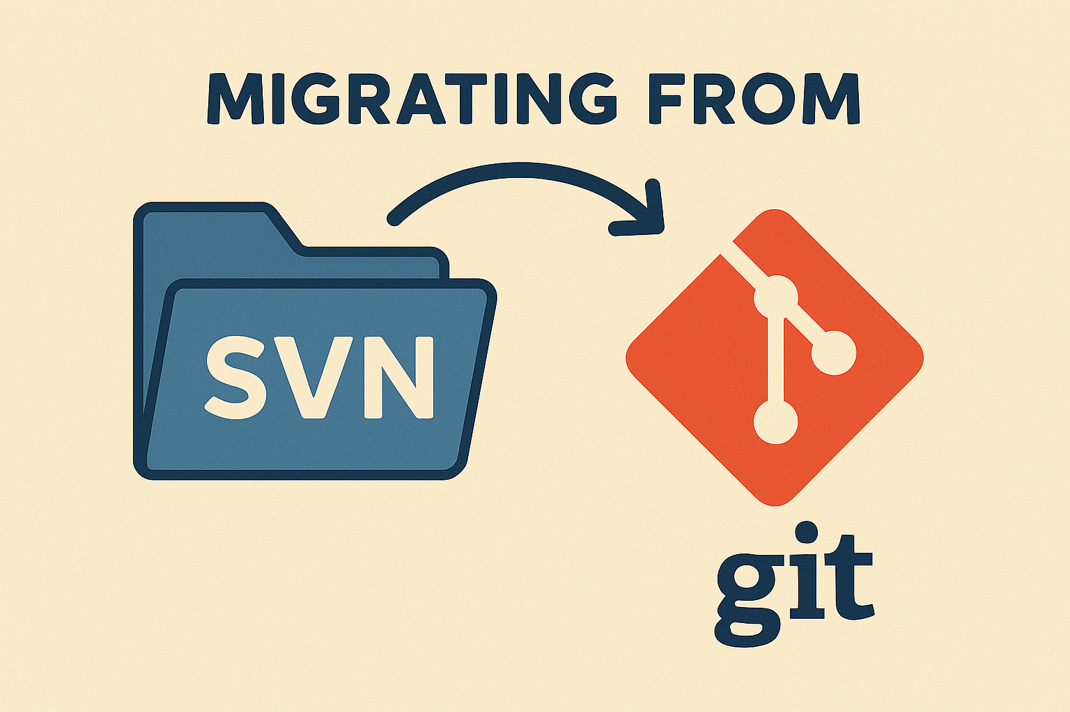

Slide 2
Content
Current status
Migration Plan
  3 git repositories
  Storage
  Archive of SVN repository

Slide 3
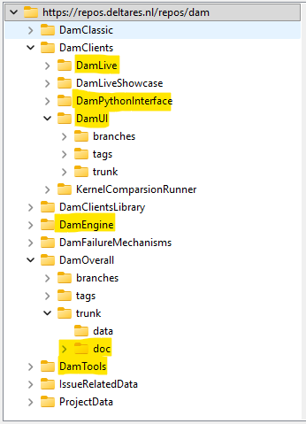
Current status
Name | Link
DAM | https://repos.deltares.nl/repos/dam
DAM projects | https://repos.deltares.nl/repos/DAM-Projecten
Project | Size (in MB)
DamLive | 190
DamPythonInterface | 32
DamUI | 817
DamEngine | 90
DamOverall-doc | 53
DamTools | 107
IssueRelatedData | 15500
ProjectData | 1850
DAM-Projecten: 247 MB

Slide 4
Migration plan
Migrate relevant parts to 3 new git repositories
Move data to storage
Archive original SVN DAM repository

Slide 5
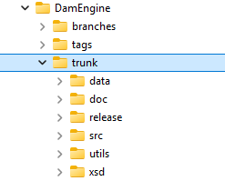
New git repositories (1)
DamEngine
Migrate only trunk
With full history

Slide 6
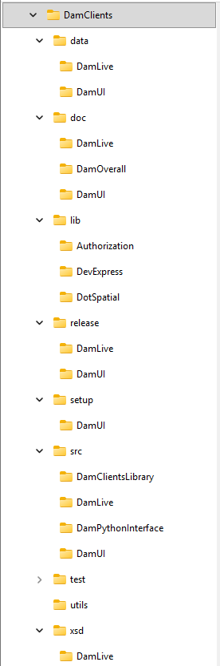
New git repositories (2)
DamClients
Reorganize
Migrate without history

Slide 7
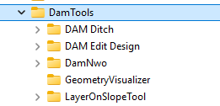
New git repositories (3)
DamTools
Migrate only trunks
Without history

Slide 8
Storage
Data stored in DAM issues data will be moved from the repository to a storage location.

Slide 9
Archive original SVN DAM repository
Keep alive (for bugfix releases)
After next release Dam and Damlive -> read-only

Slide 10


