Slide 1

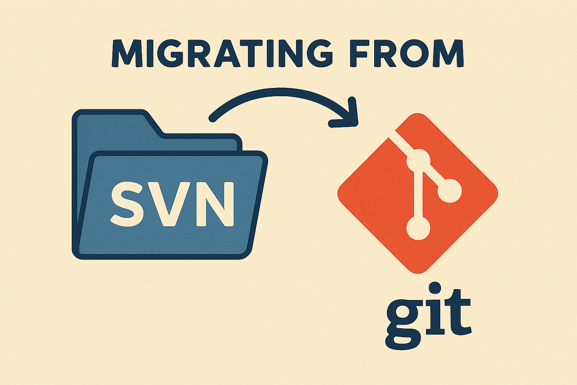

Slide 2
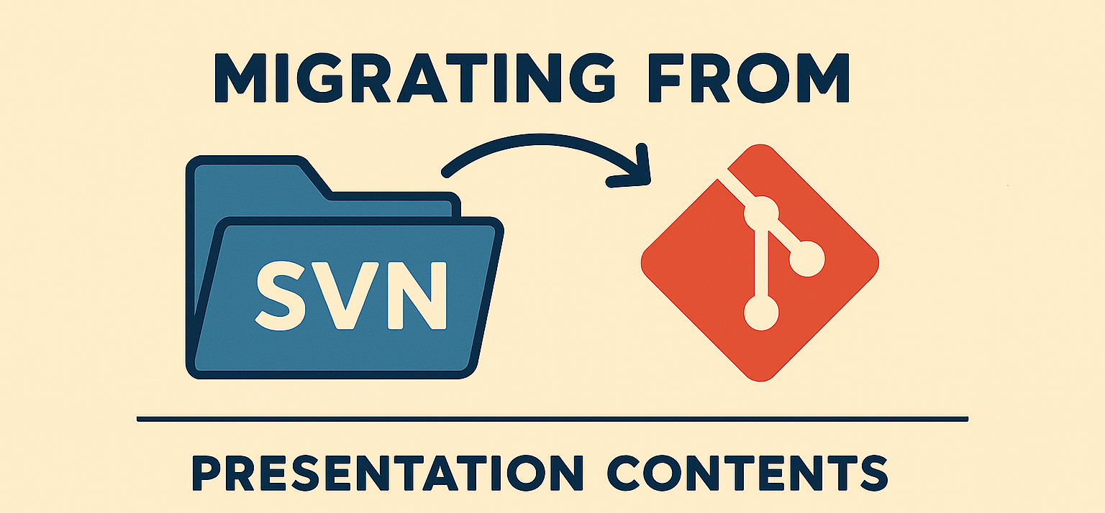
Content
Current status
Migration Plan
  3 git repositories (alternatives presented)
  Storage
  Archive of SVN repository
Choose how to migrate

Slide 3
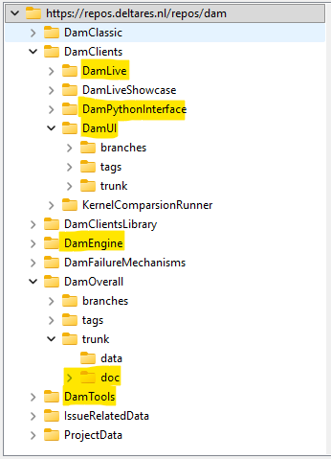

Current status
Name | Link
DAM | https://repos.deltares.nl/repos/dam
DAM projects | https://repos.deltares.nl/repos/DAM-Projecten
Project | Size (in MB)
DamLive | 190
DamPythonInterface | 32
DamUI | 817
DamEngine | 90
DamOverall-doc | 53
DamTools | 107
IssueRelatedData | 15500
ProjectData | 1850
DAM-Projecten: 247 MB

Slide 4

Migration plan
Migrate relevant parts to 3 new git repositories
Move data to storage
Archive original SVN DAM repository

Slide 5
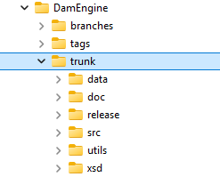

New git repositories (1 DamEngine)
DamEngine
With full history
Migrate only trunk
To be decided: migrate tags/branches?

Slide 6
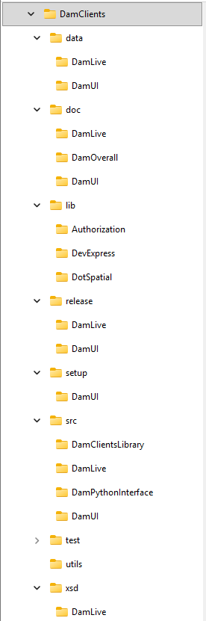
New git repositories (2a DamClients)
DamClients
Migrate without history
Reorganize with doc/data/src/… as main folders
Each main folder has client parts (Dam, DamLive etc.)
DamClientsLibrary is put in .\src
Pros:
DamClientsLibrary can be accessed directly by all clients
Cons:
The client specific parts are distributed throughout the main folders

Slide 7
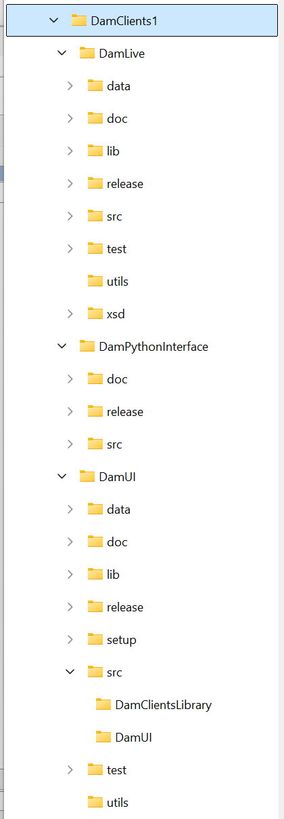
New git repositories (2b DamClients)
DamClients
Migrate without history
Reorganize with the clients as main folders and put DamClientsLibrary in DamUI
Access DamClientsLibrary as nuget package in DamLive
Pros:
Clients are isolated in the source tree
DamClientsLibrary can be different for DamUI and DamLive
Cons:
DamClientsLibrary has to be implemented as a nuget package in DamLive

Slide 8
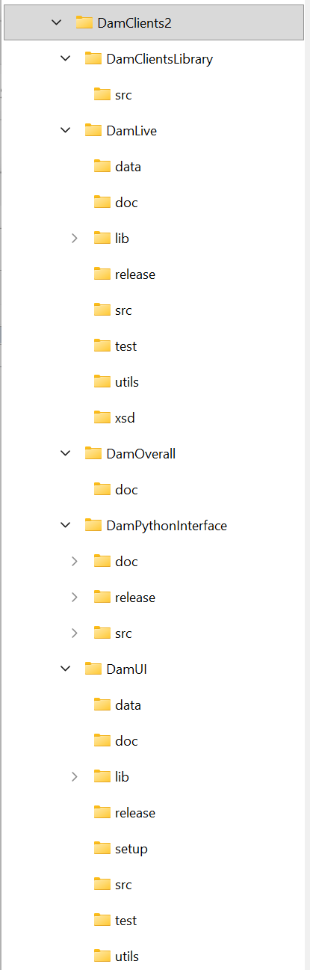
New git repositories (2c DamClients)
DamClients
Migrate without history
Reorganize with the clients as main folders
DamClientsLibrary on same level of clients
Pros:
Clients are isolated in the source tree
DamClientsLibrary can be accessed directly by all clients
Cons:
DamClientsLibrary has to be accessed through folders above root of solution
DamClientsLibrary has always to be the same for DamUI and DamLive

Slide 9
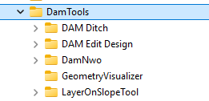
New git repositories (3)
DamTools
Migrate only trunks
Without history

Slide 10
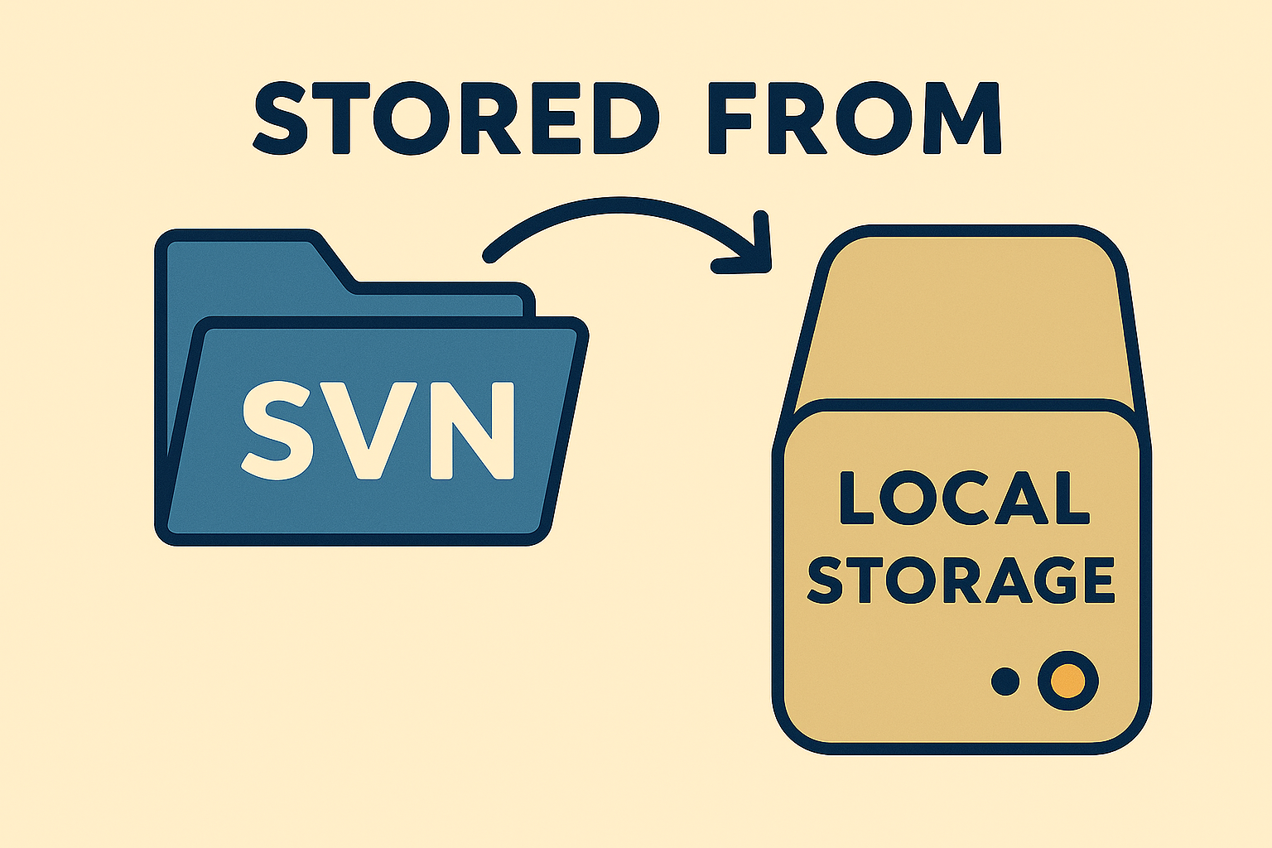
Storage
Data stored in DAM issues data will be moved from the repository to a storage location.

Slide 11
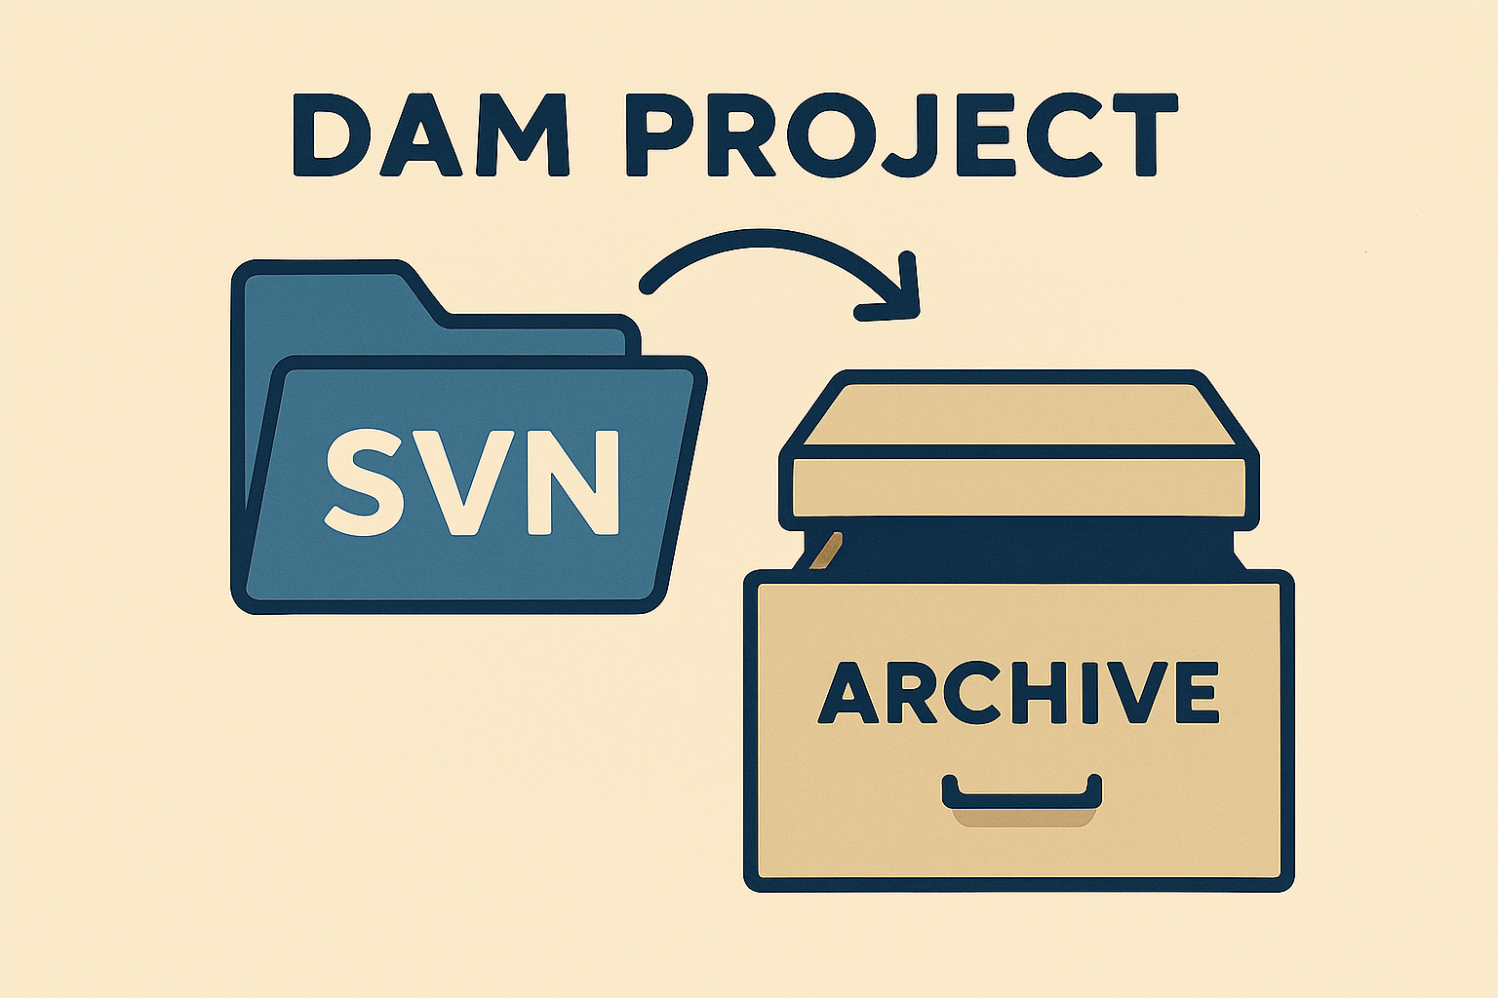
Archive original SVN DAM repository
Keep alive (for bugfix releases)
After next release Dam and Damlive -> read-only

Slide 12


Slide 13


