Slide 1

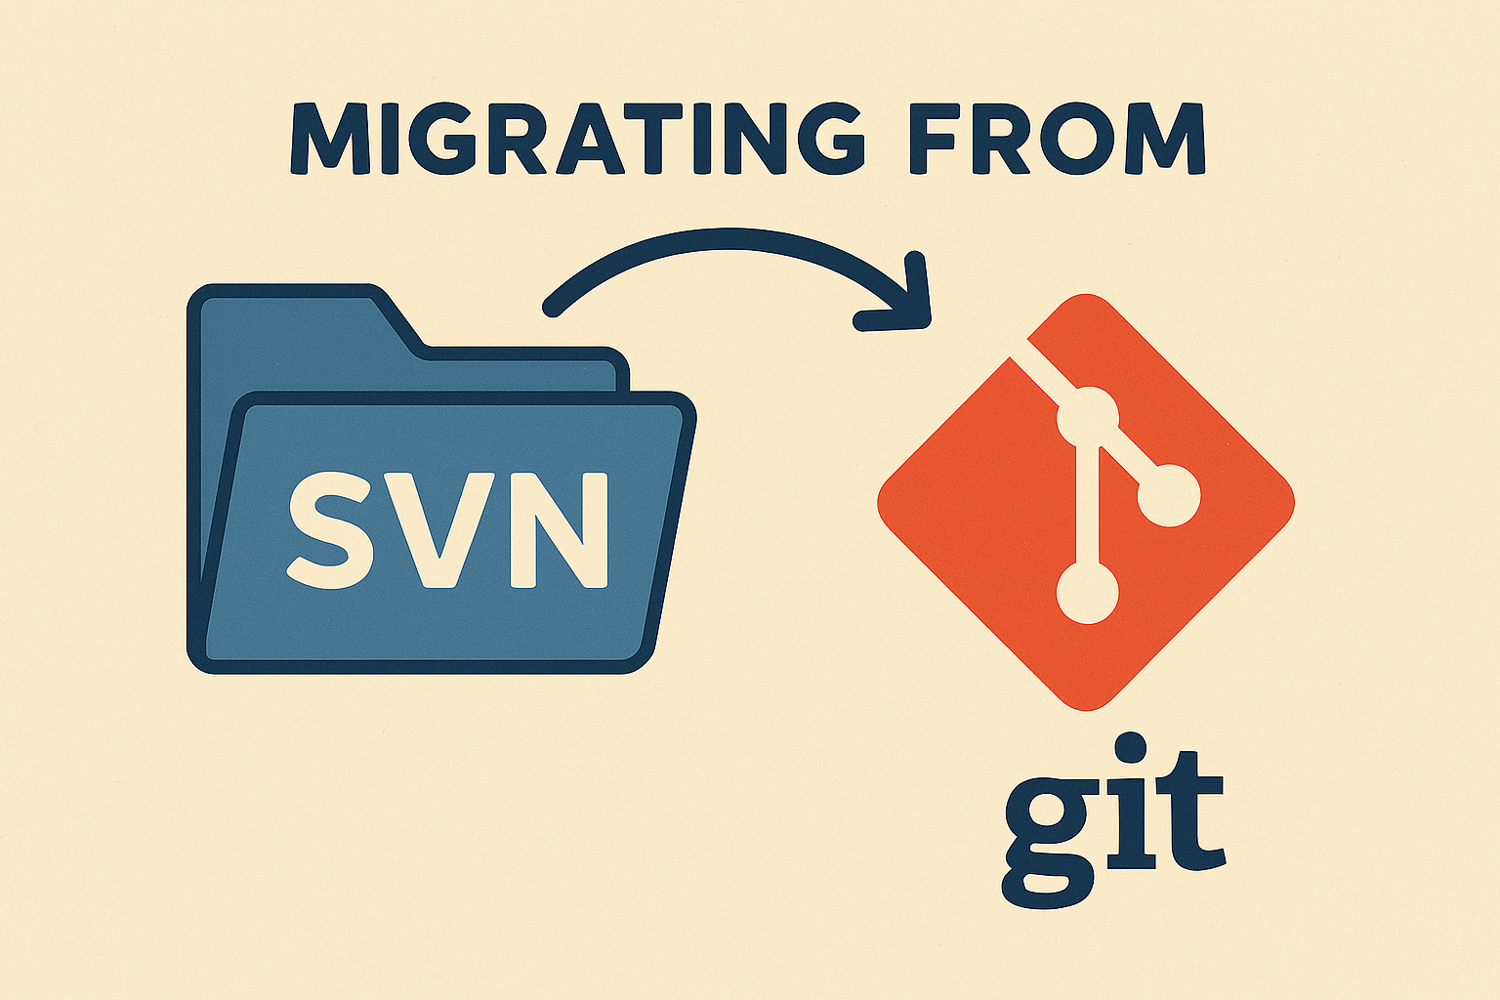

Slide 2
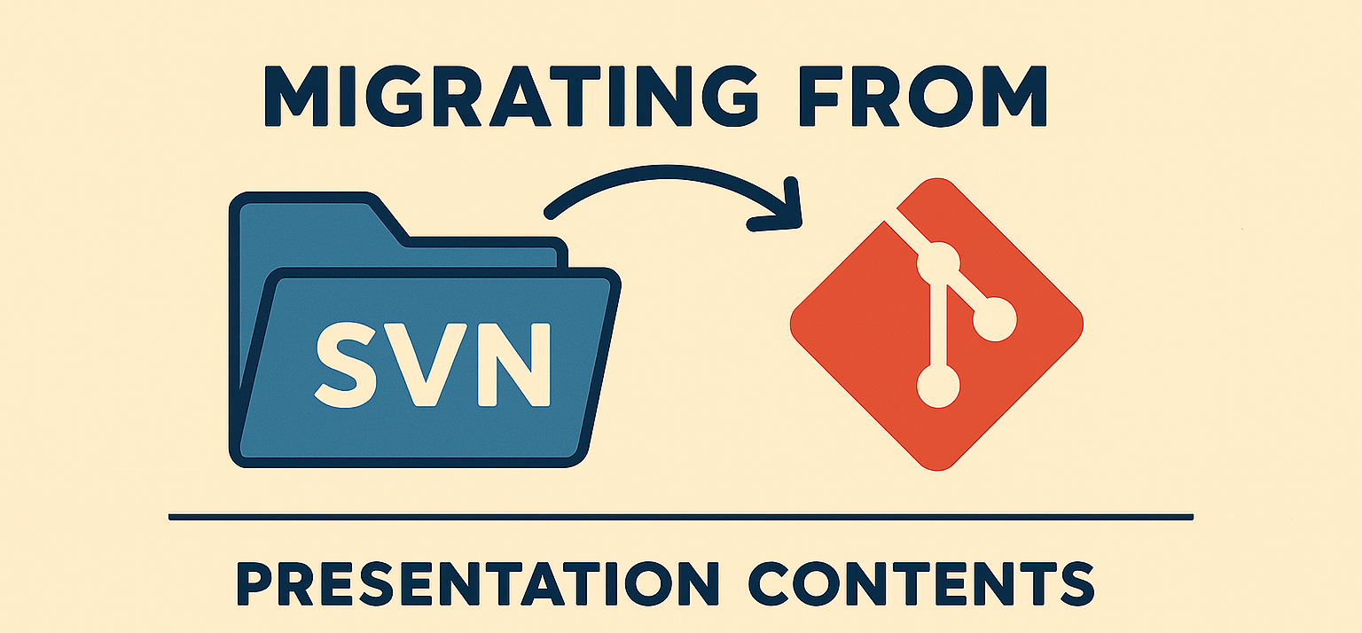
Content
Current status
Migration Plan
  4 git repositories (alternatives presented)
  Storage
  Archive of SVN repository
Choose how to migrate

Slide 3
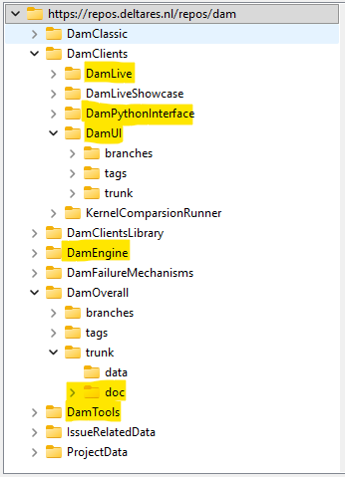

Current status
Name | Link
DAM | https://repos.deltares.nl/repos/dam
DAM projects | https://repos.deltares.nl/repos/DAM-Projecten
Project | Size (in MB)
DamLive | 190
DamPythonInterface | 32
DamUI | 817
DamEngine | 90
DamOverall-doc | 53
DamTools | 107
IssueRelatedData | 15500
ProjectData | 1850
DAM-Projecten: 247 MB

Slide 4
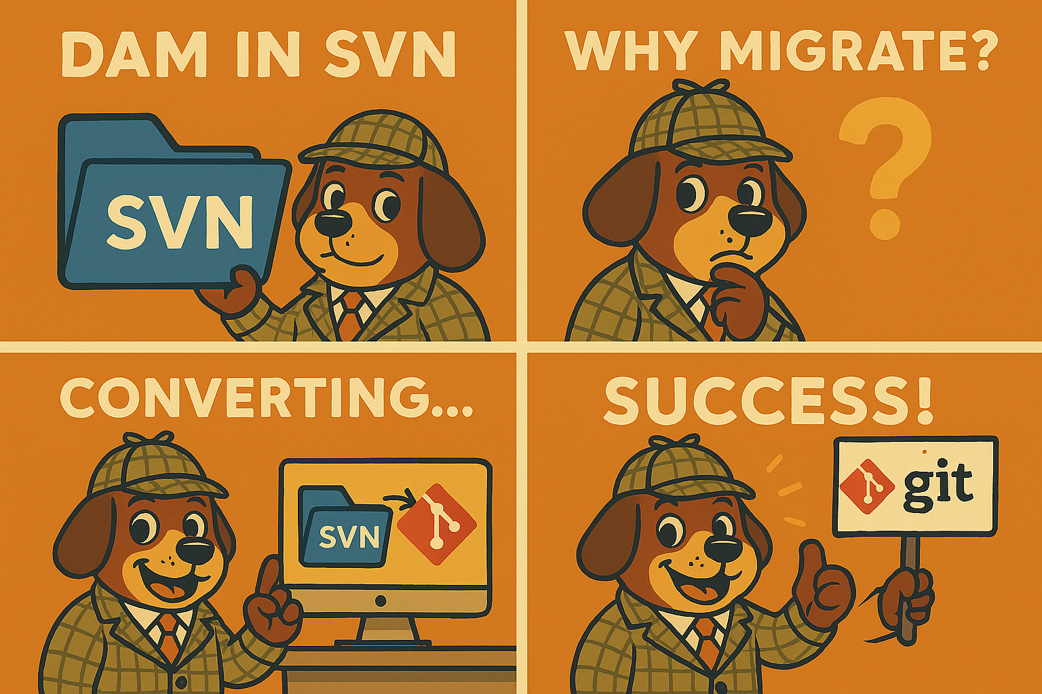
Migration plan
Migrate relevant parts to 4 new git repositories
Move data to storage
Archive original SVN DAM repository

Slide 5
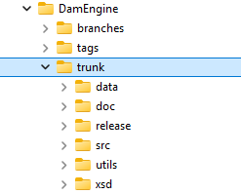

New git repositories (1 DamEngine)
DamEngine
With full history
Migrate only trunk
To be decided: migrate tags/branches?

Slide 6
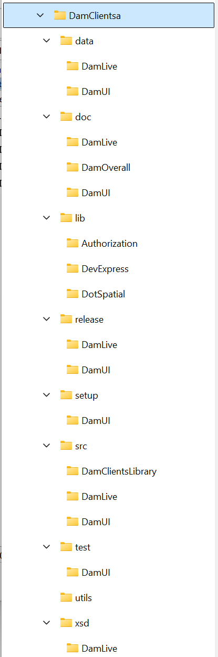
New git repositories (2a DamClients)
DamClients
Migrate without history
Reorganize with doc/data/src/… as main folders
Each main folder has client parts (Dam, DamLive etc.)
DamClientsLibrary is put in .\src
Pros:
DamClientsLibrary can be accessed directly by all clients
Cons:
The client specific parts are distributed throughout the main folders

Slide 7
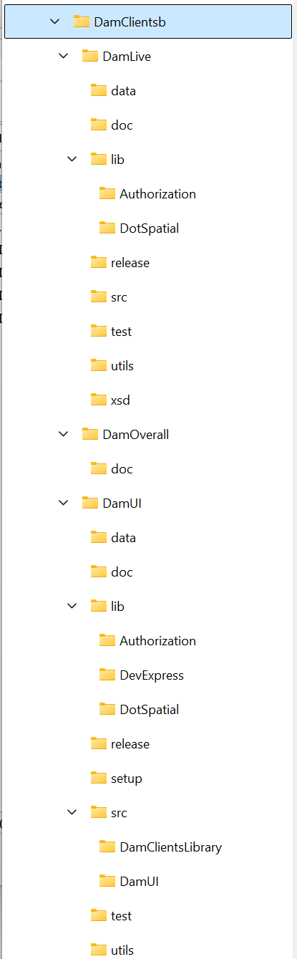
New git repositories (2b DamClients)
DamClients
Migrate without history
Reorganize with the clients as main folders and put DamClientsLibrary in DamUI
Access DamClientsLibrary as nuget package in DamLive
Pros:
Clients are isolated in the source tree
DamClientsLibrary can be different for DamUI and DamLive
Cons:
DamClientsLibrary has to be implemented as a nuget package in DamLive

Slide 8
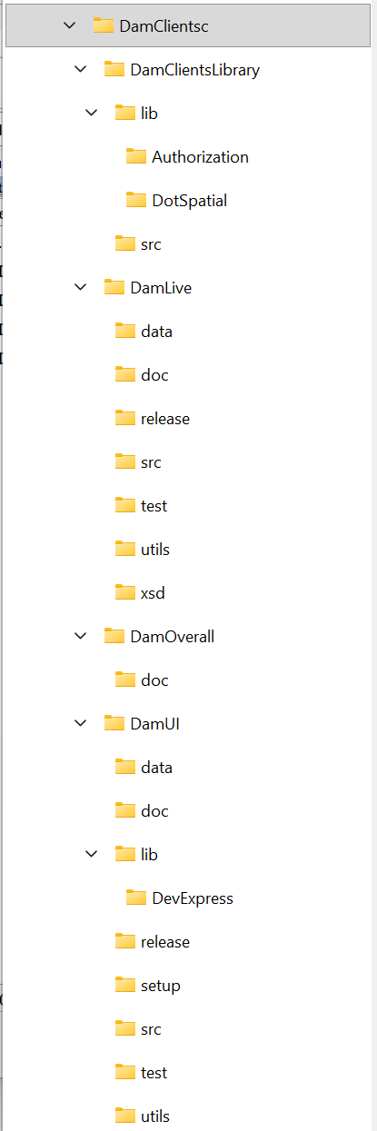
New git repositories (2c DamClients)
DamClients
Migrate without history
Reorganize with the clients as main folders
DamClientsLibrary on same level of clients
Pros:
Clients are isolated in the source tree
DamClientsLibrary can be accessed directly by all clients
Cons:
DamClientsLibrary has to be accessed through folders above root of solution
DamClientsLibrary has always to be the same for DamUI and DamLive

Slide 9
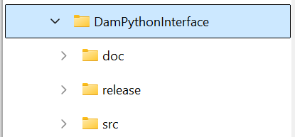
New git repositories (3)
DamPythonInterface
With history
Migrate only trunk

Slide 10
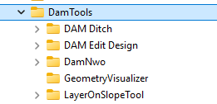
New git repositories (4)
DamTools
Without history
Migrate only trunks

Slide 11
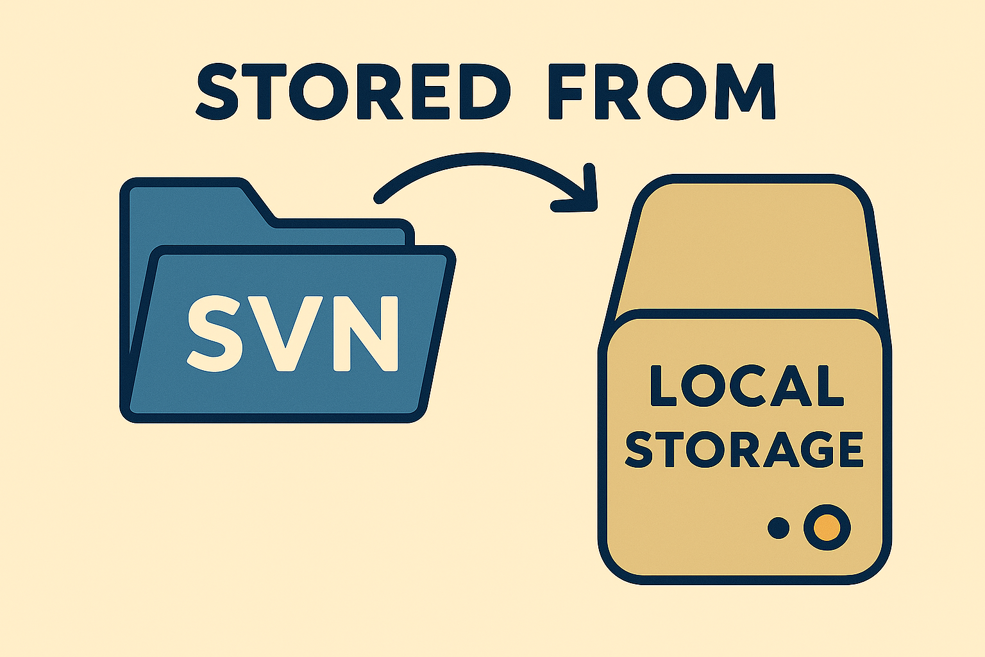
Storage
Data stored in DAM issues data will be moved from the repository to a storage location.

Slide 12
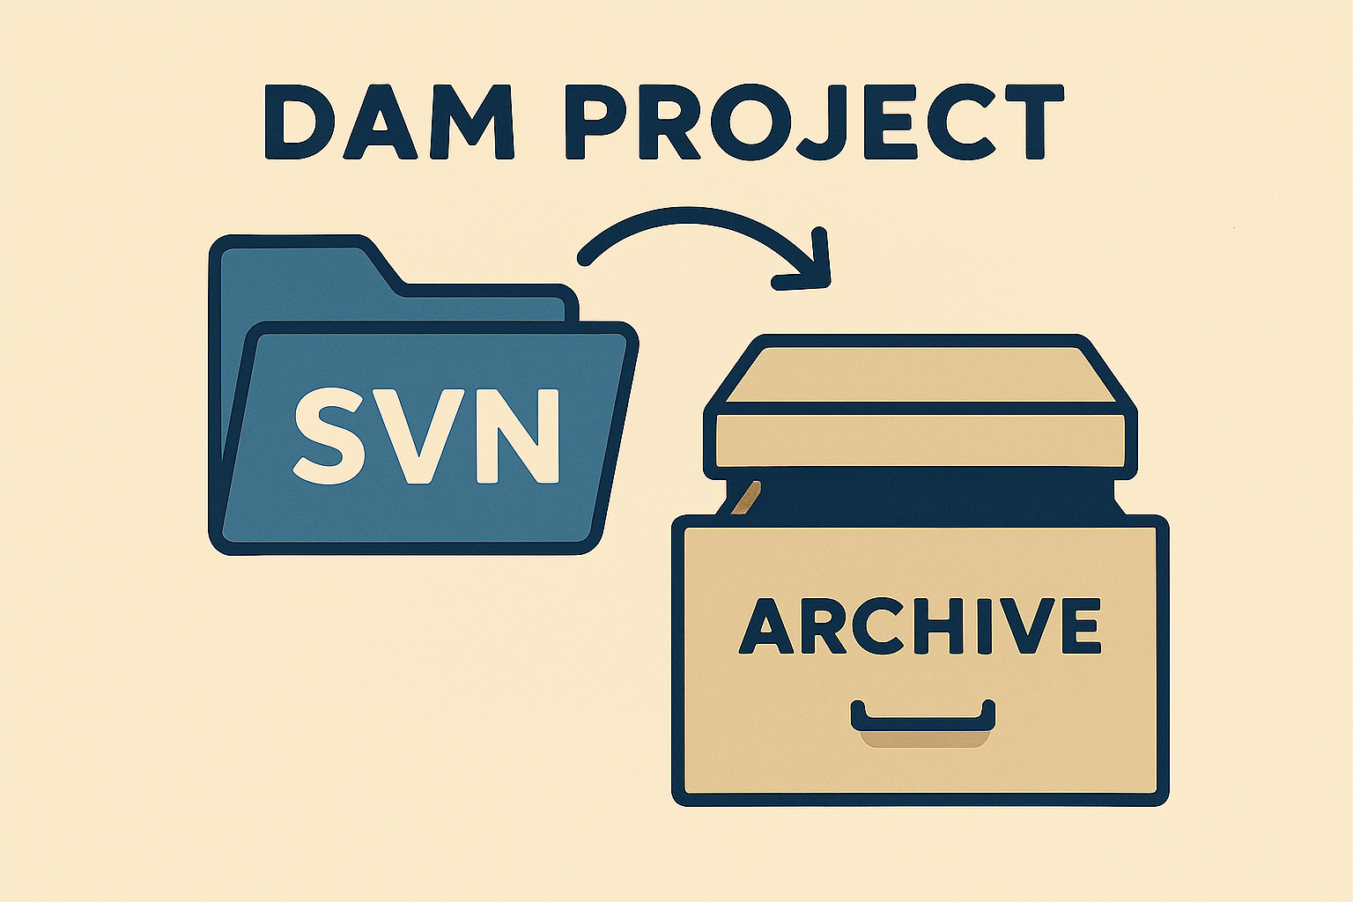
Archive original SVN DAM repository
Keep alive (for bugfix releases)
After next release Dam and Damlive -> read-only

Slide 13


Slide 14

Agreed upon solution
We migrate to 4 new git repositories (DamEngine, DamClients, DamPythonInterface, DamTools).
We choose the solution 2c for the DamClients repository.
We do not migrate branches and tags.
We keep the history of the trunk of the DamEngine repository.
If possible: we keep part of history of DamClients repository (the history of the DamUI trunk of the original SVN repository.
We rename the namespaces of DamUI from Dam.Deltares… to DamUI.Deltares…
We rename where necessary the folders to be the same as the namespaces of the projects.
For storage: we do not migrate the Issue related data and the Project data, but just agree upon a location where we can store them in the future.
Old releases of DamUI and DamLive have to be archived. The location has to be decided.
The old Dam SVN repository will be available for a minimum of 5 years and will be made read-only after new releases of DamUI and DamLive have been made.

