Slide 1

Combining a 2D soil profile with a surface line to produce a new 2D soil profile
Including the geometry (re-) generator
John Bokma
Naam Achternaam

Slide 2

What’s in store?
Geometry definition
Surface line definition
2D soil profile definition
Considerations
Preprocessing combining 2D soil profiles with a surface line
Generic geometry (re-)generator
Postprocessing the new 2D geometry to get the 2D soil profile.

Slide 3
Geometry definition
A geometry consists of points, curves, loops and surfaces.
Point: a point with 2 coordinates (X,Z).
Curve: a line between 2 points as reference (startpoint, endpoint).
Loop: a closed collection of (at least 3) connected curves (as reference) circumferencing an area.
Surface: a plane with 1 outer loop (the enclosing loop; as reference) and 0 or more inner loops (a loop that lies entirely within the outerloop; as reference).
SurfaceLine property: a property which holds the top line of the geometry (updated with method UpdateSurfaceLine). This is not to be confused with the surface line object.
A valid geometry contains:
At least 1 valid surface with 1 valid outerloop.
Only the loops that are used in the surfaces.
Only the curves that are used in the loops.
Only the points that are used in the curves and each point is unique.

Slide 4
Surface line definition
A surface line consists of a series of points defined from left to right.
Point: a point with 2 coordinates (X,Z).
The points must be unique and strictly increasing in X-direction.
Next to its coordinates, a point can also have a characteristic type definition. But as that has no role in the generation process, it is therefor not explained in detail here.
A valid surface line contains:
At least 2 points that are defined strictly increasing in X- direction.

Slide 5
2D soil profile definition
A 2D soil profile consists of a 2D geometry and a list of 2D layers.
The 2D geometry is already explained.
The list of 2D layers holds per 2D layer :
  A (geometry) surface as reference to a surface in the 2D geometry.
  A soil material name.
  Aquifer status (Aquifer or Aquitard).
  Water pressure interpolation model.
A valid 2D soil profile contains:
A valid 2D geometry.
A list of 2D layers which contains as many items as there are surfaces in the geometry.
Each soil material name must have a match in the general list of soil materials.

Slide 6
Considerations
The proces starts with a VALID 2D Soil Profile, a VALID surface line and a VALID filling material.
Combining a 2D Soil Profile with a surface line to create a new 2D Soil Profile is a multi step process.
A number of pre-processing steps specific to this combination is required.
After the pre-processing a generic (re-)generator is used to create the new full 2D geometry that results from the combination.
The generic generator involves all steps that are required for generating based on a “new” geometry as well as an existing geometry with some “new” elements (points and curves).
After the generation, a number of post processing steps is needed to create the required full new 2D Soil Profile.

Slide 7
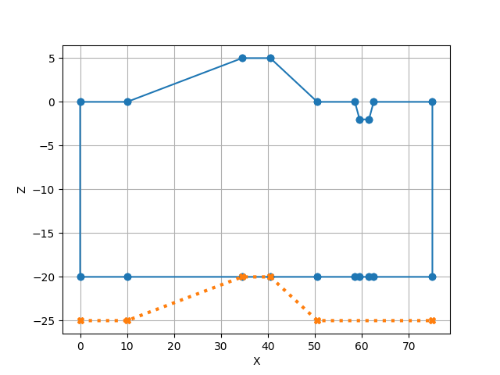
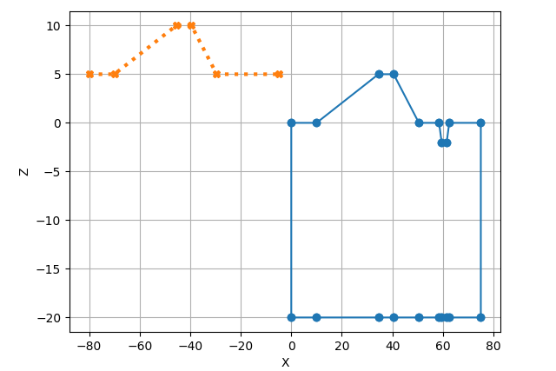
Preprocessing
Validation of the given 2D soil profile, surface line and filling material.
Validation of the position of the surface line versus the position of the soil profile:
  The surface line must be above the bottom of the soil profile.
  The surface line must at least partially overlap the soil profile (i.e. the surface line may not be completely to the left or completely to the right of the soil profile).

Slide 8
Preprocessing 2
Create local copies of both soil profile and surface line to prevent that these originals are changed.
All further steps are performed using the copies.
Round all coordinates in the soil profile and surface line to 3 decimals.
Create a new 2D Soil Profile as place holder for the result profile.
Create a new 2D Geometry as place holder for the result geometry.

Slide 9
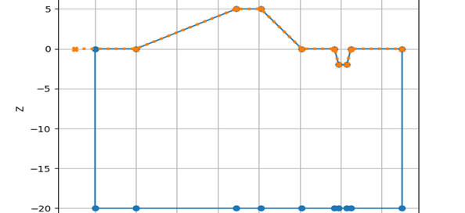
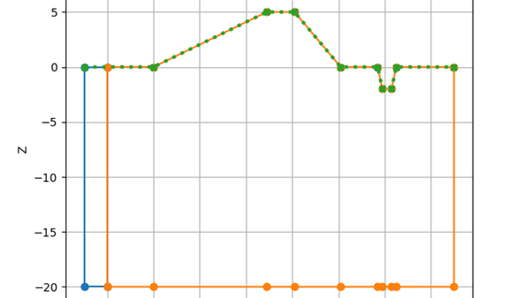
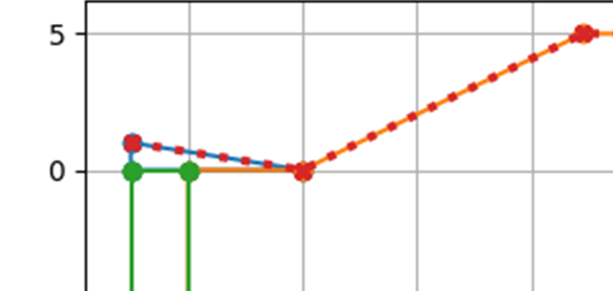
Preprocessing (2)
Fill the result geometry by combining the given geometry with the surface line:
  Adapt the geometry to the limits of the surface line by extending and/or cutting the geometry. With extending the material(s) of the layer(s) next to the extended surface(s) is used for this/these surfaces.
  To this geometry add the surface line (as points and curves), adding extra vertical curves at the limits when needed.

Slide 10
Preprocessing (3)
Make a copy of the resulting soil profile to reconstruct the materials in the postprocessing
Add all points as newly added points, add all curves as newly added curves to the result geometry. These newly added items form the basis for the regeneration process here.
Remove all points, curves, loops and surfaces from the result geometry to get rid of existing geometry data so we start the (re-)generation proces with a fresh “new” geometry.

Slide 11
Geometry (re-)generator
As stated before this is a generic generator. It is based on the Plaxis generator and handles completely new geometries as well as editted geometries. These edits were in fact event driven and can concern points, curves and loops. As these edits had multiple entry points in the generation process, some code is irrelevant for the combination process discussed here. It is nevertheless mentioned here, marked as italic text.
Start by locking the surfaces list to ensure that (re-)generation is thread safe.
Remove all double points from the newly effected points/curves.
Add the newly effected points to points.
Add the newly effected curves to curves.
Set up the curve-surfaces associations.

Slide 12


Geometry (re-)generator (2)
Break up all curves at any intersection:
Merge coinciding points introduced by the previous step, removing obsolete curves when found.
Remove invalid and duplicated curves introduced by the first step.
Setup two dictionaries (CurveForwardsIsUsed, CurveBackwardIsUsed) to keep track of whether all curves are handled in both directions (which signals the process is done).
Start detecting surfaces….
The generation is done when all curves are handled in both forward and backward direction.
p1
p4
p1
p3
p3
p2
p2

Slide 13
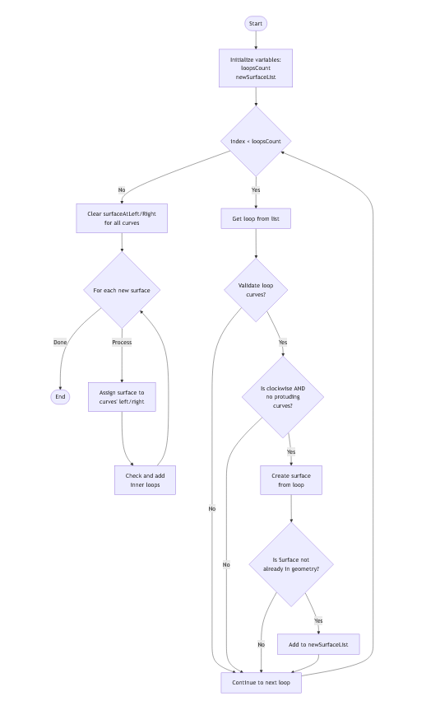
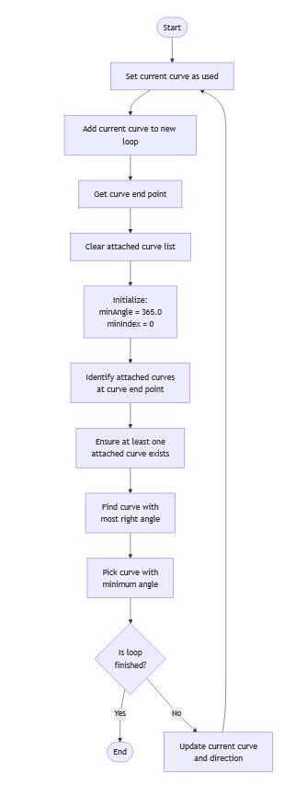
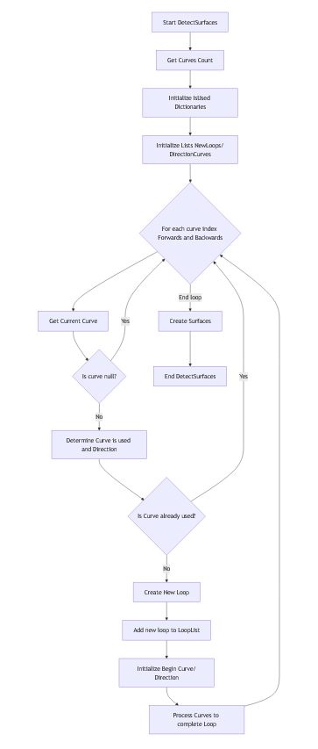
Detecting and creating surfaces in flow chart

Slide 14
Geometry (re-)generator (3): Detecting surfaces
Detecting the surfaces uses the Plaxis algorithm which involves two program loops:
Create a list for the new geometry loops.
Create a list of direction curves. A direction curve is an object that holds the direction of the curve next to the curve itself. It offers the head/endpoint of the curve based on the direction, i.e. the headpoint becomes the endpoint when the direction is backwards.
Start looping through all existing curves with curve 1 in a forward direction as current curve. This is the outerloop of the algorithm to check all relevant curves which could become geometry loops. Note that every curve is handled twice: once with a forward direction and once with a backward direction:
  Check whether the currect curve with direction is already handled by cheking the IsUsed dictionaries. If it is already handled, skip the innerloop and start with the next direction and/or curve as current curve/direction. Note that any curve can only ever be used twice at maximum, once in a forward direction in a given loop and once in a backward direction in a different given loop. So not every outerloop-run will actually perform the inner loop as the curve and its direction is already part of a geometry loop.
  Create a new geometry loop and add the current curve, remembering this curve and its direction as startcurve so you can check whether the innerloop is finished i.e. when the next connected curve equals the start curve and its direction.
  Start the innerloop looking for all curves that are connected to the endpoint of the current curve.

Slide 15
Geometry (re-)generator (4): Detecting surfaces
  If there is more than 1 connected curve, select the one that turns clockwise most as and add that to the geometry loop. If there is only one connected curve, add that one to the loop. If there is no curve found, something is wrong and an error is raised.
  Add the current curve to the proper IsUsed dictionary based on its direction.
  Update the current direction curve with the found connected direction curve.
  Continue the innerloop with the updated current curve to find the next connected one and add that to the geometry loop and update dictionary and current curve again.
  Keep doing this until the next connected curve equals the startcurve which means the geometry loop is ready and thus also the inner program loop is ready.
  Add the new loop to the list of new geometry loops.
  Continue the outerloop with the same curve in the backward direction or the next curve in the forward direction.Do this until all curves are handled for both directions.
  Now all possible geometry loops are known and these can be used to create the new geometry surfaces.

Slide 16


Geometry (re-)generator (5): Creating surfaces
Creating the geometry surfaces based on the found geomerty loops involves for each loop:
Check the validity of the loop (is it continuous, does it have an area). If it is invalid ignore it.
Check if the loop is clockwise and does not contain protruding curves that turn back on themselves. If not ok, ignore it.
Check that the loop is not already part of the geometry by making sure there is no other loop with the same curves. If not ok, ignore it.
Add the loop as loop and as surface to the geometry.
Check for innerloops and add these when found
Assign SurfaceAtLeft/SurfaceAtRight properties of all curves.

Slide 17
Geometry (re-)generator (6): Finalizing (re-)generation
To finalize the (re-)generation process:
Remove all newly effected points.
Remove all newly effected curves.
Update the surface line property of the geometry.
Return the generated geometry.

Slide 18
Postprocessing
Now the result geometry has been generated, delete all loose points and curves that may have been left/produced in the process. A loose point/curve is a point/curve that is not part of any loop in the result geometry.
Add the result geometry to the result soil profile.
Remove all geometry data (points, curves, loops and surfaces) that are above the surface line.
Initialize the properties of the surfaces (IsAquifer = false, material = filling material, Water pressure interpolation model = Automatic).
Reconstruct the surfaces, i.e. find out which new surfaces are equal to the old original surfaces and then copy their properties (IsAquifer, material, Water pressure interpolation model).
Copy the pre-consolidation stresses from the original 2D soil profile to the new one.
Rebox (= set the proper limits) the new geometry of the new profile.
Update the surface line property of the new geometry.
Round the coordinates of the new geometry to 3 decimals.

