Slide 1
Management
Policy
Assessment
Calamities
Analysis/communications
Calculation (models)
Schematisation
Base data

Slide 2
Hydraulic
load
DAM
Dikes strength Analysis Module
Consequenses
Results, analysis and presentation
(i.e. GIS, FEWS and webapplications)
Stability analysis in batch
(SlopeW, Bishop , Uplift, Piping etc.)
Automatic crosssection generation, based on schematization algorithmes
(i.e. legal guide lines and expert knowledge)
Interpreted data based on field measurement (Raw data)
Subsoil
Based on geotechnical survey an measurements
Geometry
Based on measurements (laser altimetry, GPS etc.)
Observations
Based on dike inspections
Hydraulic model
Base on geohydraulic measurements

Slide 3
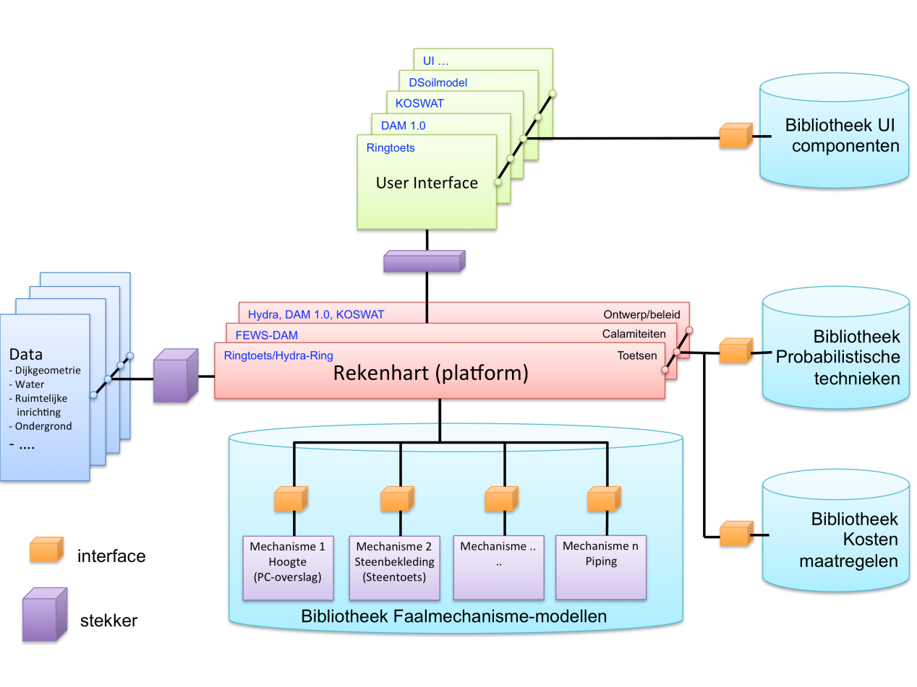
A
B
A
B

Slide 4
Calamity prevention
Assessment
Major maintenance
Contribution to third-party plans
Response to third-party plans
Base data
Calamity response
Maintenance of approval
Drafting policy plans
Inspection
Granting exemptions

Slide 5
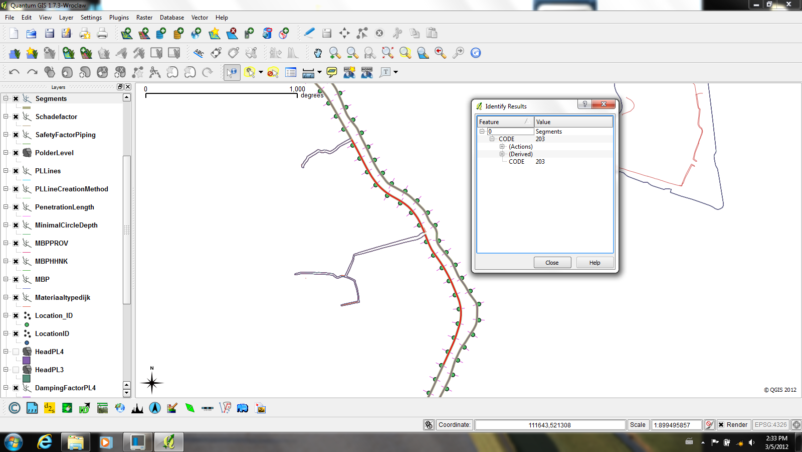

Slide 6
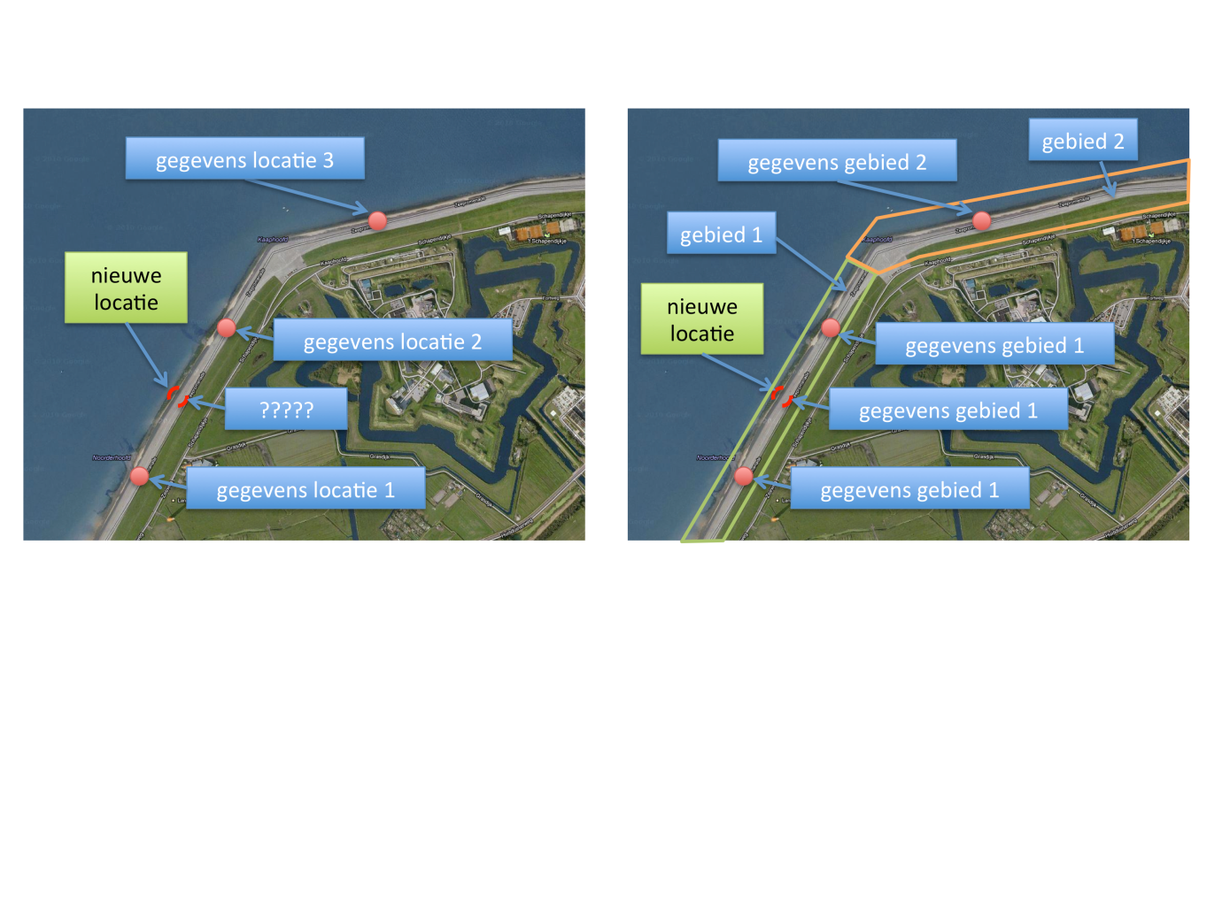
Area 2
Data location 3
Data area 2
Area 1
New location
New location
Data location 2
Data area 1
Data area 1
Data location 1
Data area 1

Slide 7
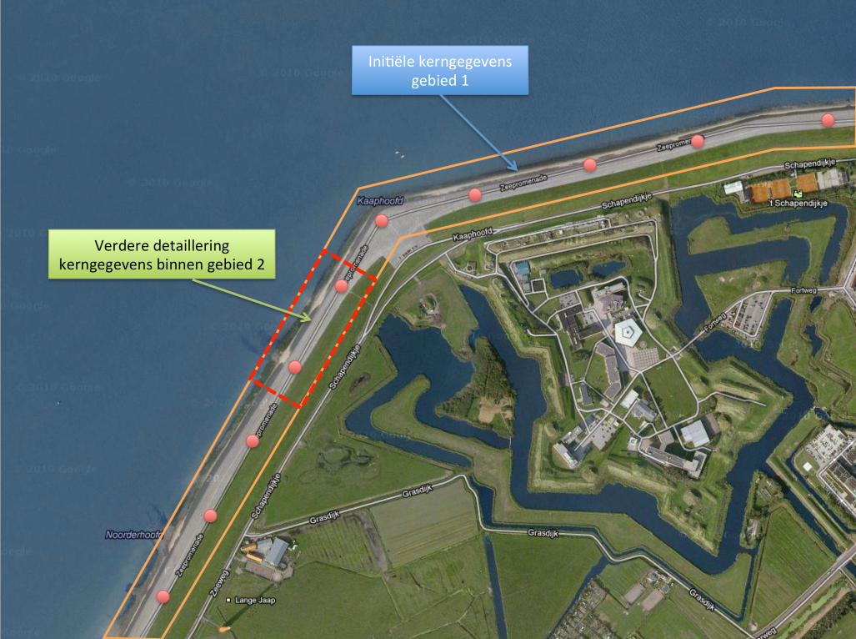
Initial base
data area 1
More detail for base data in area 2

Slide 8
Hydraulic
load
DAM
Dikes strength Analysis Module
Consequenses
Results, analysis and presentation
(i.e. GIS, FEWS and webapplications)
Stability analysis in batch
(SlopeW, Bishop , Uplift, Piping etc.)
Automatic crosssection generation, based on schematization algorithmes
(i.e. legal guide lines and expert knowledge)
Interpreted data based on field measurement (Raw data)
Subsoil
Based on geotechnical survey an measurements
Geometry
Based on measurements (laser altimetry, GPS etc.)
Observations
Based on dike inspections
Hydraulic model
Base on geohydraulic measurements

Slide 9
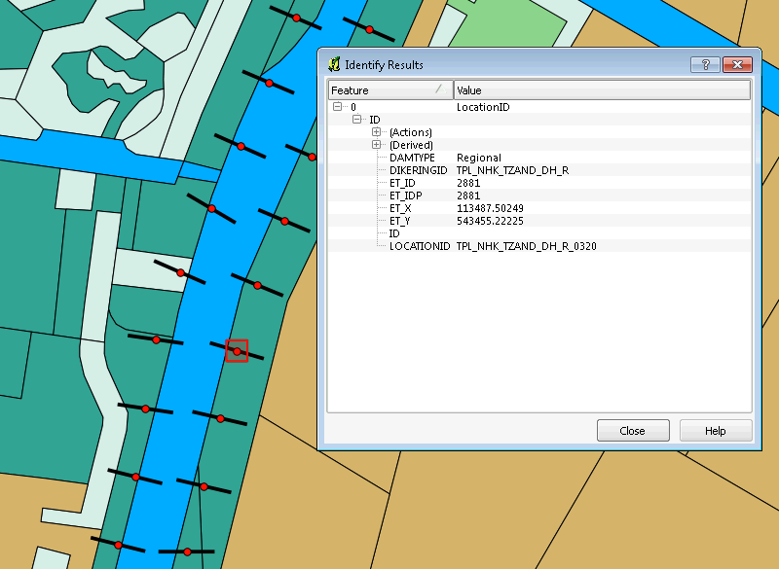
Notes:
LocationID and cross section

Slide 10
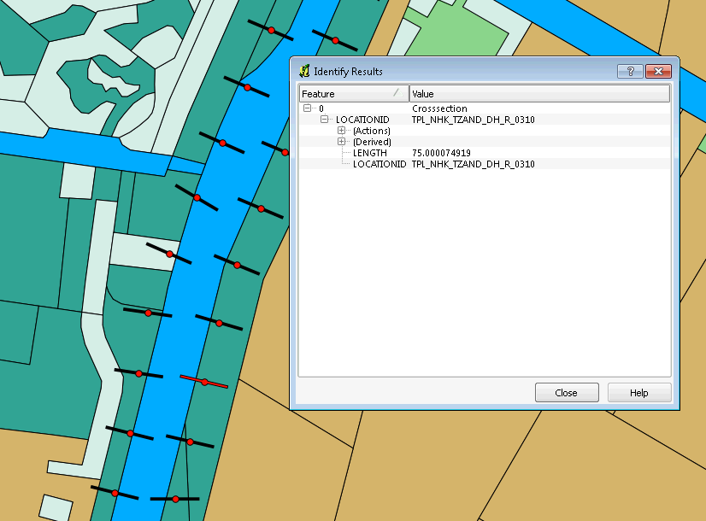
Notes:
LocationID and cross section

Slide 11
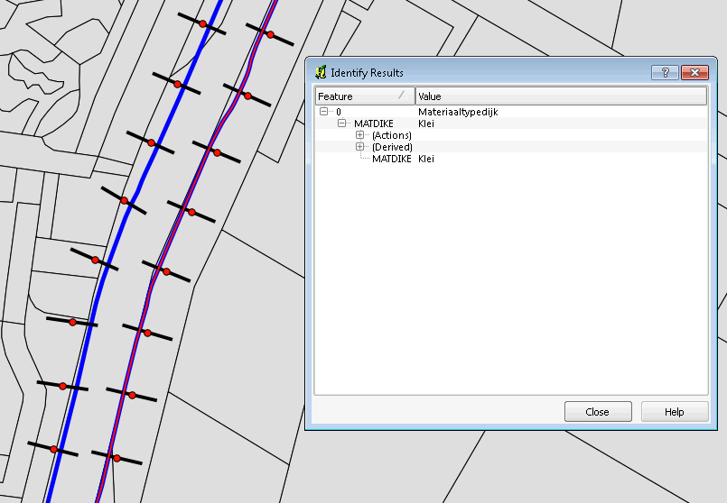

Slide 12
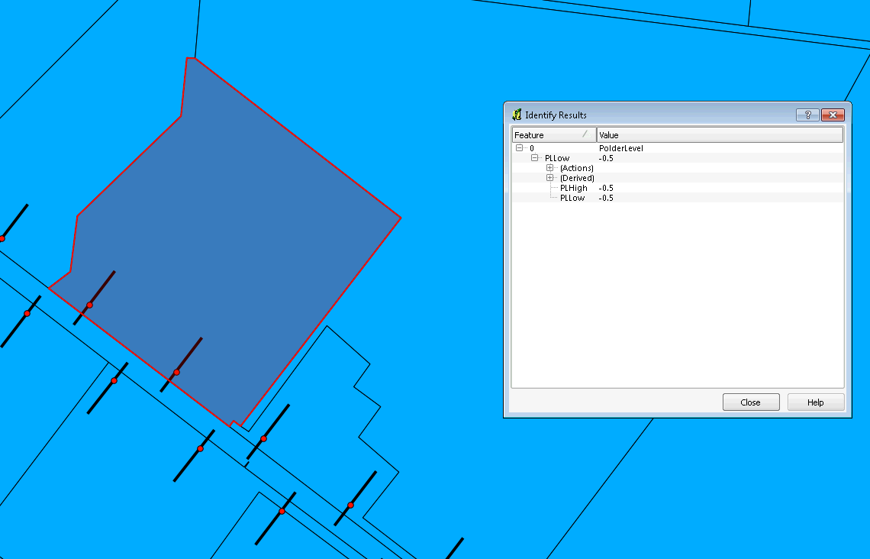

Slide 13
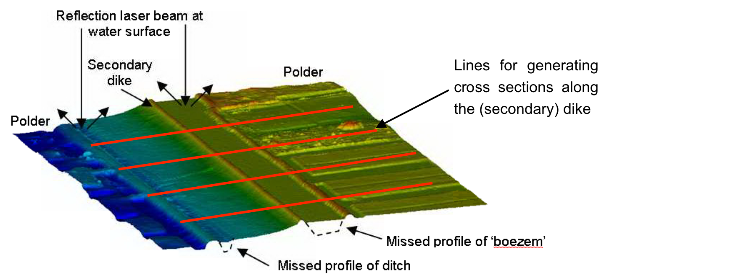

Slide 14
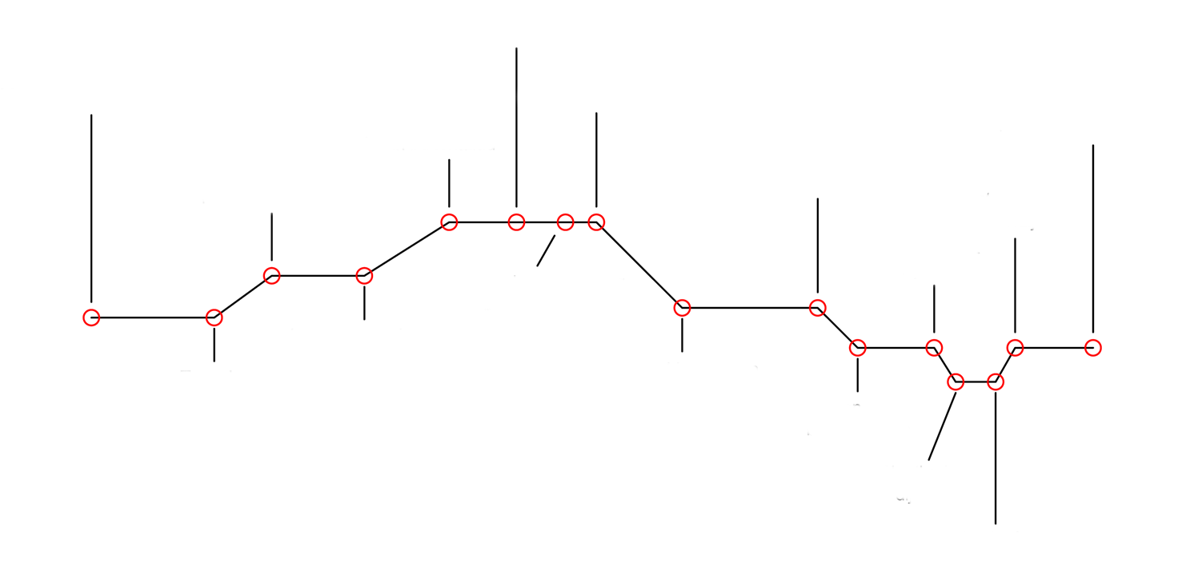
Traffic load outside
Surface level outside
Dike top at polder
Surface level inside
Dike top at river
Shoulder top outside
Shoulder top inside
Ditch polder side
Traffic load inside
Ditch dike side
Shoulder base outside
Shoulder base inside
Dike toe at river
Dike toe at polder
Bottom ditch dike side
Bottom ditch polderside

Slide 15
Locatie.shp
Cross-section.shp
LOCATIONID
(DAM 1.0 Locatie)
Surfacelines.csv
Characteristicpoints.csv

Slide 16
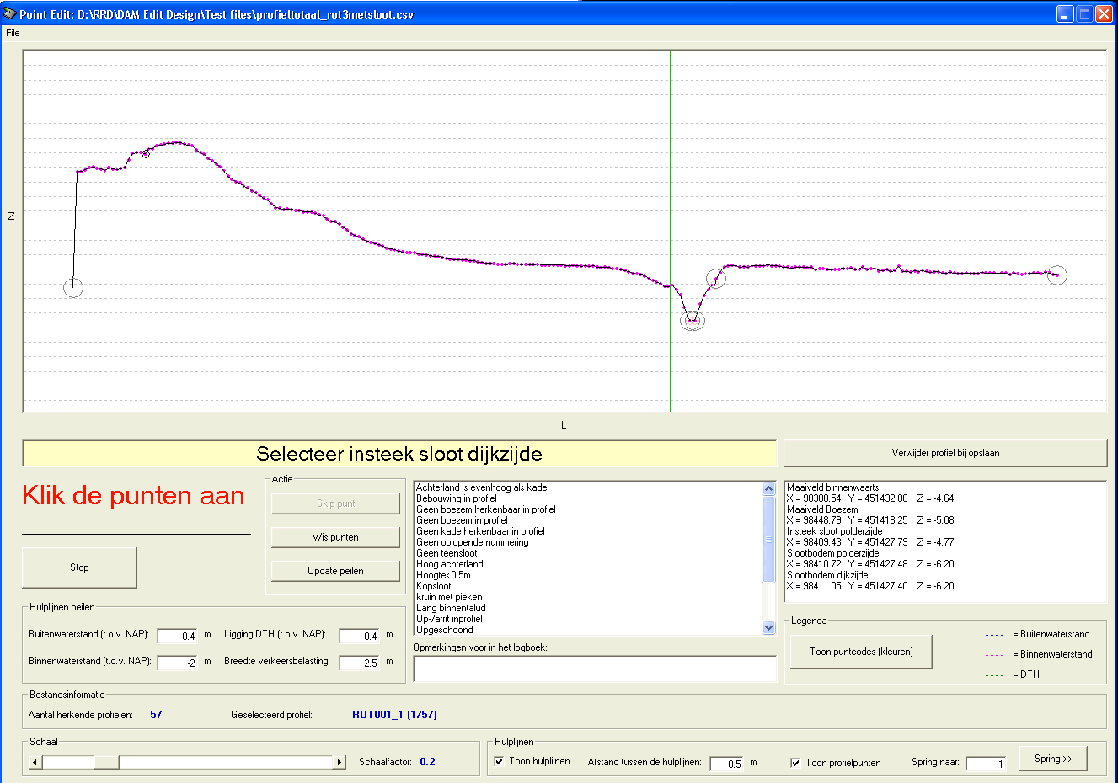

Slide 17
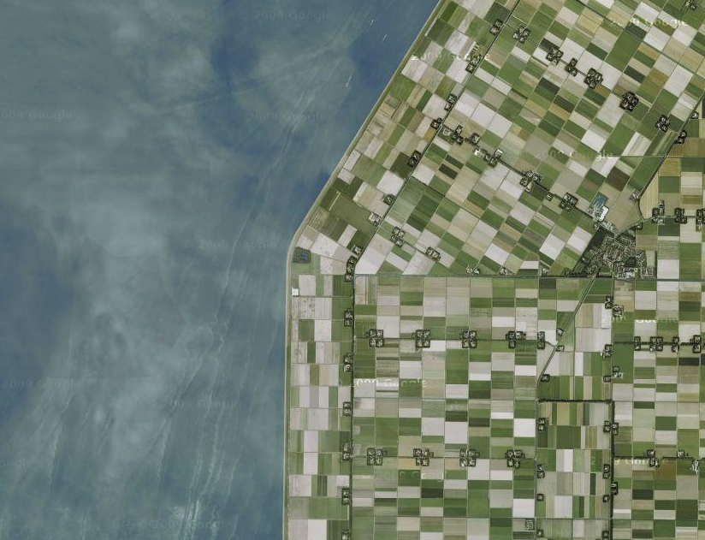
Segment 3
Segment 2
Segment 1

Slide 18
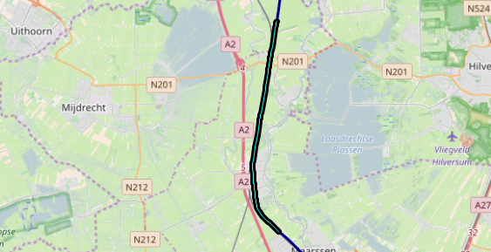
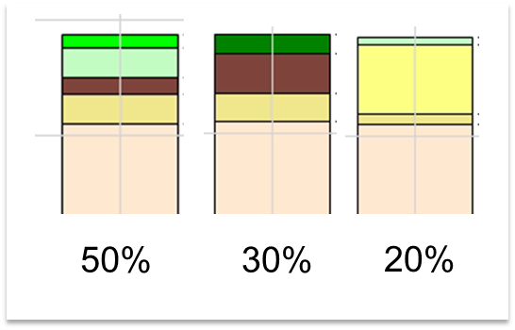

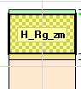
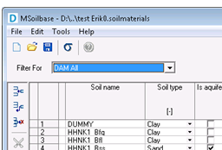
Properties:
Soil segments -> location
Situated on map
Soil segment -> soil scenario
Name soil profiles
Probability
Soil profile -> soil layers
Layer boundaries
Soil layer -> material name
Material name
Aquifer y/n
Material name
Soil type
Parameters
Material -> parameters

Slide 19
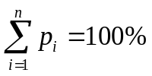
1D₁ soil profile, P₁
Segment 1
1D_{n} soil profile, P_{n}
1D₁ soilprofile, P₁
Segment n
1D_{n} soil profile, P_{n}
p = probability of the presence of the 1D soil structure profile in the relevant segment

Slide 20
2
2
1D Geometries (Soilprofiles.csv)
2D Geometries
(D-Geo Stability files)
1
3
Segments.csv
Soilmodel
LocationSegments.shp
4
Soilmaterials.mdb

Slide 21
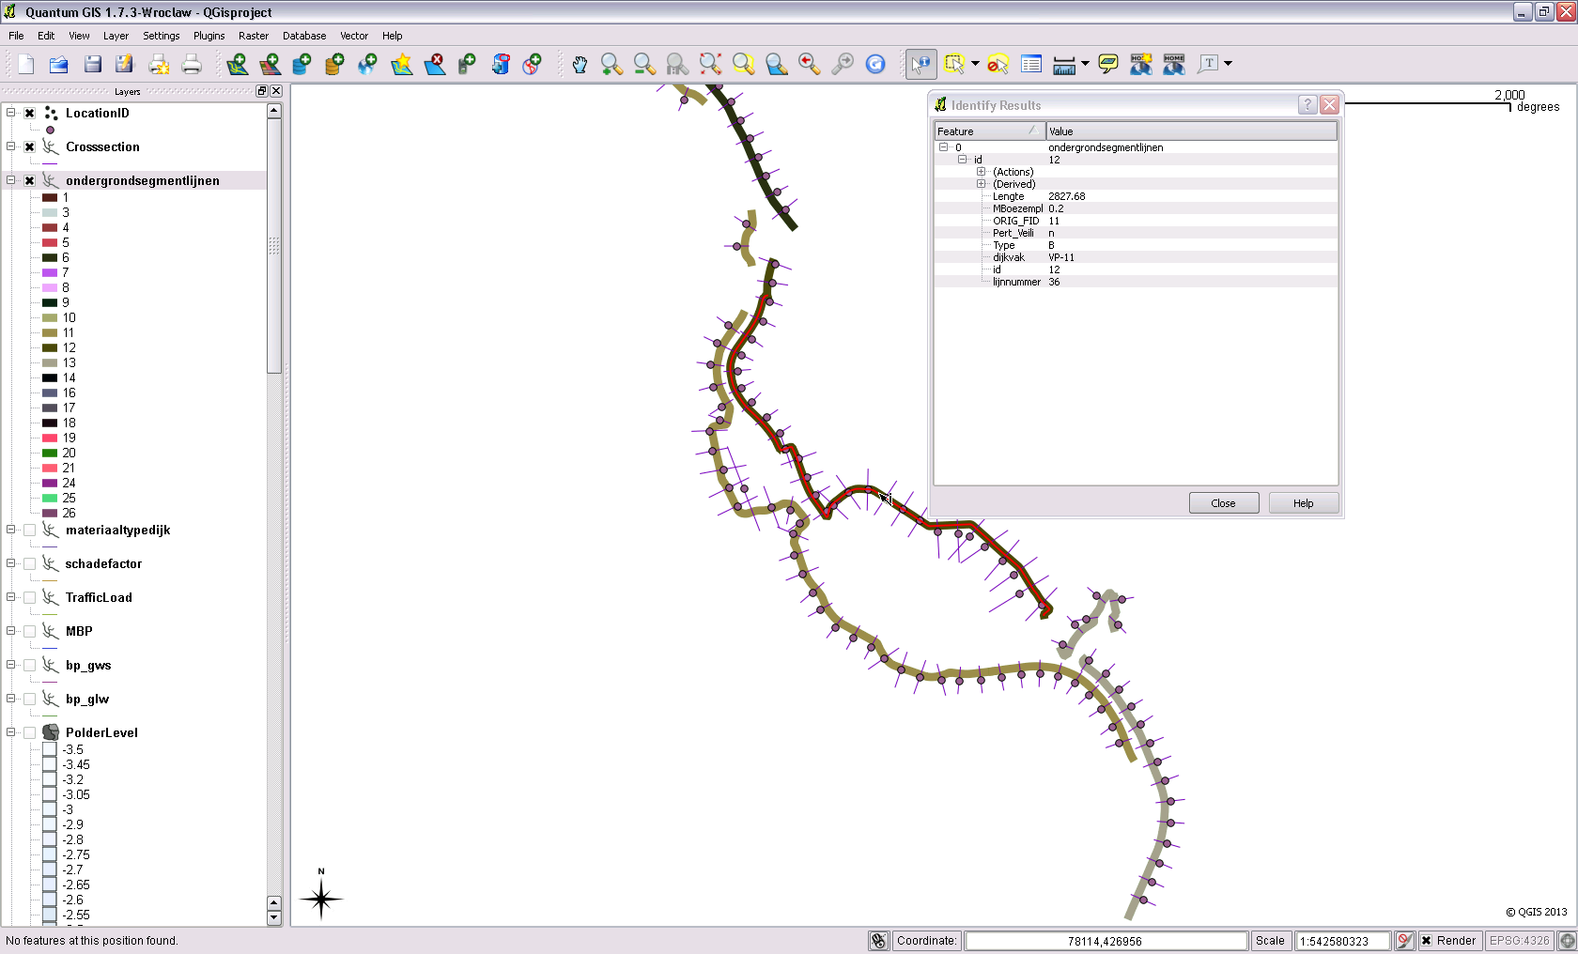

Slide 22
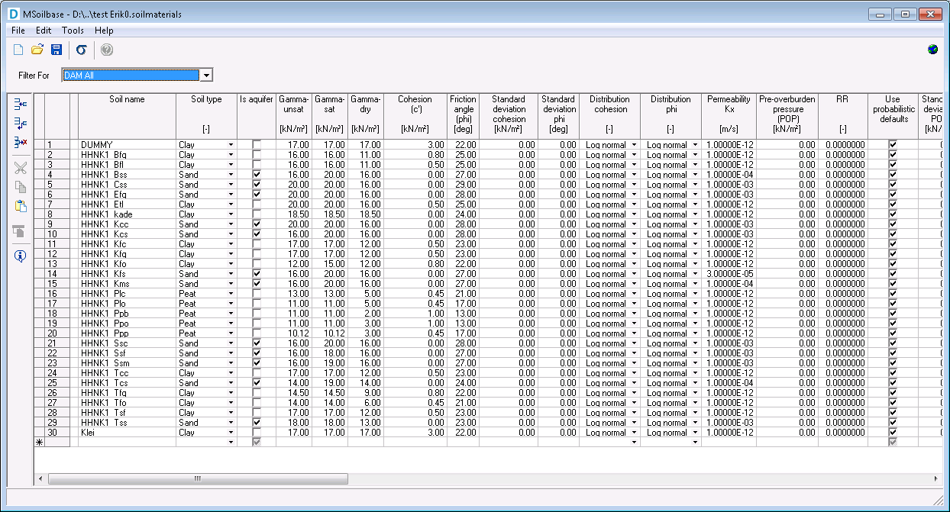
Notes:
M-Soilbase UI

Slide 23
Hydraulic
load
DAM
Dikes strength Analysis Module
Consequenses
Results, analysis and presentation
(i.e. GIS, FEWS and webapplications)
Stability analysis in batch
(SlopeW, Bishop , Uplift, Piping etc.)
Automatic crosssection generation, based on schematization algorithmes
(i.e. legal guide lines and expert knowledge)
Interpreted data based on field measurement (Raw data)
Subsoil
Based on geotechnical survey an measurements
Geometry
Based on measurements (laser altimetry, GPS etc.)
Observations
Based on dike inspections
Hydraulic model
Base on geohydraulic measurements

Slide 24
Hydraulic
load
DAM
Dikes strength Analysis Module
Consequenses
Results, analysis and presentation
(i.e. GIS, FEWS and webapplications)
Stability analysis in batch
(SlopeW, Bishop , Uplift, Piping etc.)
Automatic crosssection generation, based on schematization algorithmes
(i.e. legal guide lines and expert knowledge)
Interpreted data based on field measurement (Raw data)
Subsoil
Based on geotechnical survey an measurements
Geometry
Based on measurements (laser altimetry, GPS etc.)
Observations
Based on dike inspections
Hydraulic model
Base on geohydraulic measurements

Slide 25
Hydraulic
load
DAM
Dikes strength Analysis Module
Consequenses
Results, analysis and presentation
(i.e. GIS, FEWS and webapplications)
Stability analysis in batch
(SlopeW, Bishop , Uplift, Piping etc.)
Automatic crosssection generation, based on schematization algorithmes
(i.e. legal guide lines and expert knowledge)
Interpreted data based on field measurement (Raw data)
Subsoil
Based on geotechnical survey an measurements
Geometry
Based on measurements (laser altimetry, GPS etc.)
Observations
Based on dike inspections
Hydraulic model
Base on geohydraulic measurements

Slide 26
Schematisation freatic level
Initial schematisation water pressures
Check for uplift
Definitive schematisation water pressures

Slide 27
Dike top at river
Dike top at polder
Shoulder base inside
Dike toe at polder
River water level
A
B
C
D
Polder level
E
F
Notes:
ExpertKnowledgeRRD Binnenwaarts

Slide 28
Dike top at river
Dike top at polder
Shoulder base inside
Dike toe at polder
River water level
A
B
C
D
Polder level
E
F
Automatically corrected by DAM
Notes:
ExpertKnowledgeRRD Binnenwaarts

Slide 29
Dike top at river
Dike top at polder
Shoulder base inside
River level high
Dike toe at polder
B
C
D
Considered waterlevel
Polderlevel
A
E
F
Notes:
ExpertKnowledgeRRD Buitenwaarts

Slide 30
Dike top at river
Dike top at polder
Shoulder base inside
Dike toe at polder
River level
A
Polder level
E
F
Notes:
ExpertKnowledgeLinearInDike

Slide 31
Vertical line
PL3
PL2
PL1
Distribution pore pressure
Hydrostatic range
Dike
Cohesive layer(s)
Linear range
Penetration layer(PL2)
Linear range
First Aquifer (PL3)
Hydrostatic range

Slide 32
Piezometric head without damping
Toe at river side (entry point)
Piezometric head with damping
Toe at polder
ΔH
ΔH∙f_{demping}
Average water level (PL2)
Reduction piëzoline (x)
Polder level
Breakpoint in PL line
Intersection piëzoline and polder level
Notes:
In het geval PL2 niet gegeven is, dan wordt polderpeil gepakt.

Slide 33
Outer toe (entry point)
Piezometric head with damping
Inner toe
Uplift location 2
Uplift location 1
Polder level
Adjusted piezeometric head for uplift
Breakpoint in PL line

Slide 34
Peat embankement
no
yes
Hydraulic
shortcut
See RRD Scenario Selection flowchart for peat embankments
no
yes
Uplift
uplift
no
yes
no
yes
Scenario
8
Scenario
4, 8, 10
Scenario
7
Scenario
3, 7, 10

Slide 35
Peat embankment
no
yes
See RRD Scenario
Selection flowchart
for clay and
sand embankments
Hydraulic Shortcut
no (wet and dry)
yes (wet and dry)
yes (only dry)
Uplift
Uplift
Uplift
no
yes (dry en wet)
yes (only dry)
no
yes (dry en wet)
yes (only dry)
no
yes (dry en wet)
yes (only dry)
Scenario
6, 8
Scenario
2, 4, 6,
8, 9, 10, 11
Scenario
2, 6, 8, 9, 11
Scenario
5, 7
Scenario
1, 3, 5,
7, 9, 10, 11
Scenario
1, 5, 7, 9, 11
Scenario
5, 8
Scenario
1, 4, 5,
8, 9, 10, 11
Scenario
1, 5, 8, 9,11

Slide 36
Step 1
Storage basin < piezometric head
1st aquifer
no
Step 2
yes
There is a water-inhibiting layer at least
2 mm thick on the storage basin bed
with a volumetric weight of at least 12 kN/m2
no
Step 3
yes
Drought-sensitive embankment? Slope across
embankment > 1 m,
peat embankment and uplift safety factor
in dry conditions < 1.2
no
yes
Step 4
Thickness of the water-inhibiting layers
below the storage-basin bed
or shoring <= 5 m or thickness
of clay layer in water-inhibiting layer <= 2 meters
no
yes
Hydraulic shortcut should
not be factored in
Hydraulic shortcut
should be factored
in in dry conditions
Hydraulic shortcut
should always be factored in

Slide 37
B
DTH
α
Outer toe
B
Dike top at river
β
β
α
Dike top at polder
Dike toe at polder
Notes:
ExpertKnowledgeLinearInDike

Slide 38
Adapted profile
Initial geometry (input)
Start of adapted geometry
Adapted location for edge of inner shoulder, end of adapted geometry
Notes:
ExpertKnowledgeLinearInDike

Slide 39
Adapted profile
Initial geometry (input)
Deleted geometry points
Adapted location for toe at polderside, end of adapted geometry
Toe at riverside, start of adapted geometry
Notes:
ExpertKnowledgeLinearInDike

Slide 40
Adapted profile
Initial geometry
Deleted geometry points
Toe at riverside, start of adapted geometry
Adapted location for toe at polderside, end of adapted geometry
Notes:
ExpertKnowledgeLinearInDike

Slide 41
Adapted geometry
Inner toe in initial geometry
Initial geometry
Edge of ditch in adapted geometry
Δ
Δ
Inner toe in initial geometry
Edge of ditch in initial geometry
Location of ditch in adapted geometry
Notes:
ExpertKnowledgeLinearInDike

Slide 42
Exit point slip circle
Inner toe adjusted profile
(f_{given} = f_{calculated})
Slip circle
Δ_{S}
Δ_{S}
Intersection (S) adjusted profile with initial profile
Notes:
ExpertKnowledgeLinearInDike

Slide 43
Stability shoulder base inside
Top stability shoulder
α
Outer toe
Dike top at rivier
β
β
Dike top at polder
Δ_{S}
Δ_{S}
Toe at polderside
Intersection (S) adjusted profile with initial profile
Notes:
ExpertKnowledgeLinearInDike

Slide 44
Adapted profile
Initial geometry (input)
Deleted geometry points
Outer toe, start of adapted geometry
Adapted location of inner toe, end of adapted geometry
Notes:
ExpertKnowledgeLinearInDike

Slide 45
Adapted profile
Initial geometry (input)
Outer toe, start of adapted geometry
Adapted location of inner toe, end of adapted geometry
Notes:
ExpertKnowledgeLinearInDike

Slide 46
H_{berm}
Inner toe in adapted profile
H
Δ_{S}
Δ_{S}
Δ_{S}
L_{max}
Notes:
ExpertKnowledgeLinearInDike

Slide 47


50%
30%
20%

