Slide 1
C3S_422_Lot2_Deltares - European Services : North Sea Use Case

Slide 2
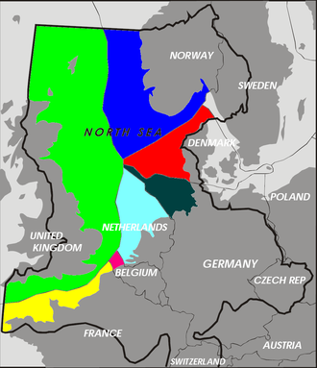
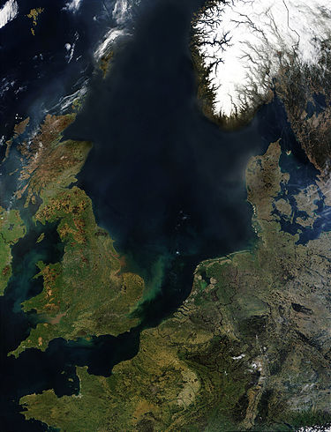
NORTH SEA USE CASE The Dutch Coast

Slide 3
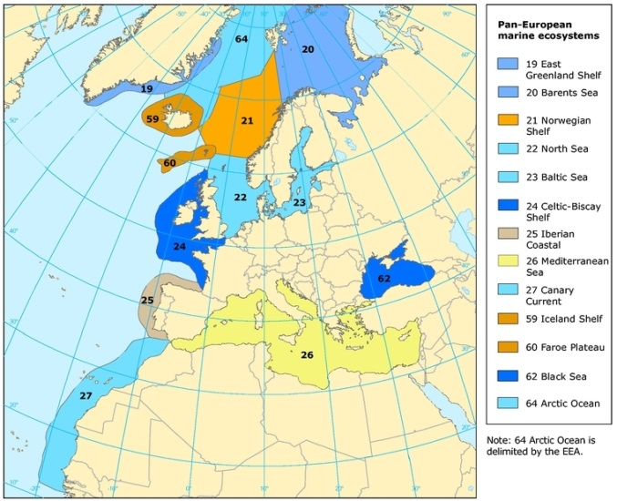
CONTENT North Sea use case
Tier 1 Datasets. Waves & Water Levels
Motivation
Modelling activities & Climate Impact
Conclusions

Slide 4
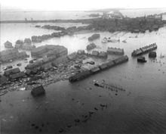
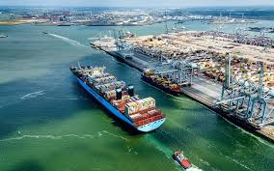
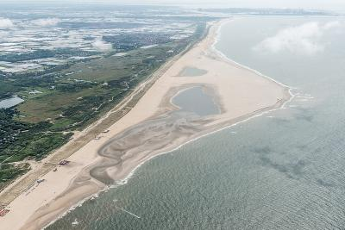
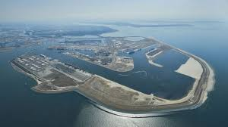
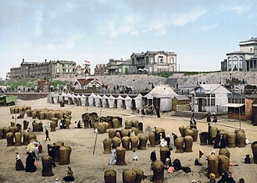
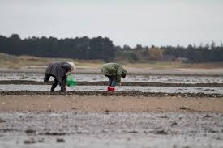
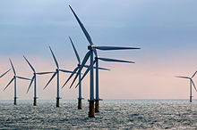
MOTIVATION North Sea use case
Defense / Protection
Port of Rotterdam
Zuid-Beveland, flood of 1953
Zandmotor
Recreation
Ecosystem / Environmental
Economic
Scheveningen, 1900
Princess Amalia Wind Farm

Slide 5
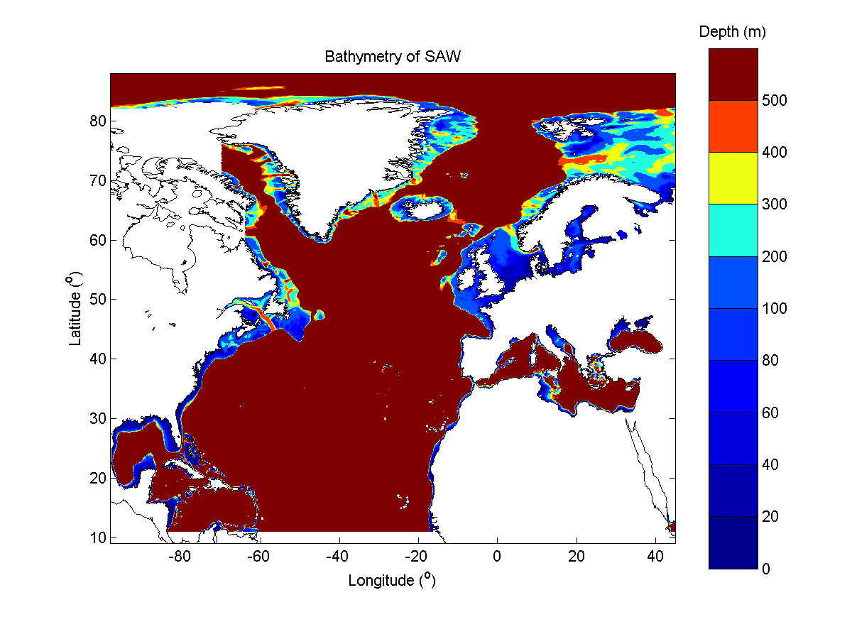
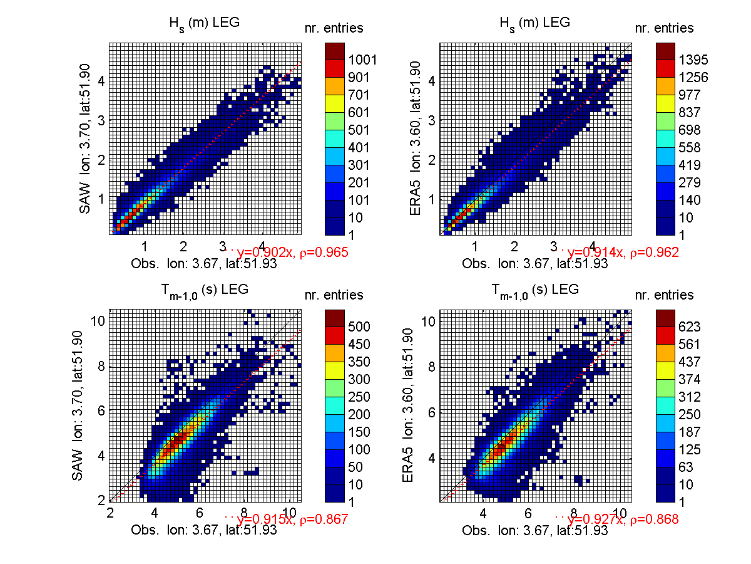
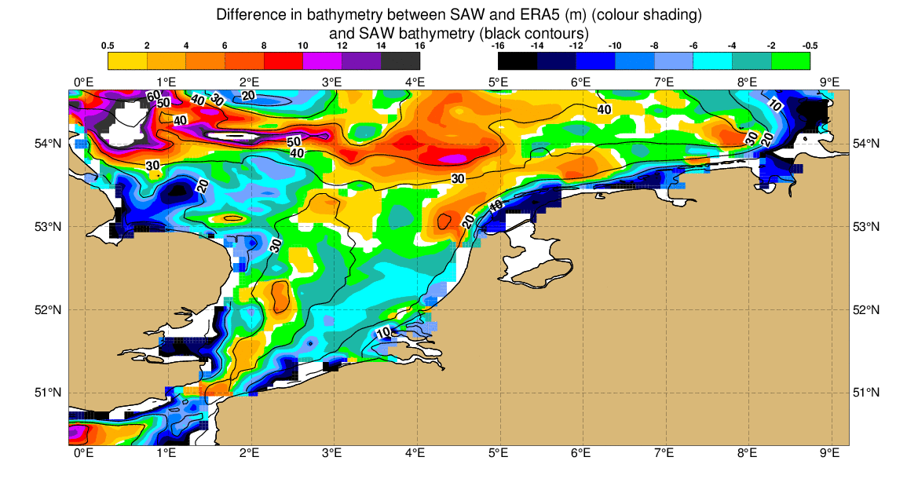
DATASETS: Waves North Sea use case
SAW @ 0.1$°$X0.1$°$ 1h
Etopo1
Model ECMWF IFS cycle 43r3
Physics ST4 (Ardhuin et al., 2010)
GCM / ERA5 winds and ice-coverage @0.3$°$
SWH, PP1D, MP1, MWD, WDW
Validation 2010-2016 obs and ERA5
Historical (1976-2005)
ERA5 (2001-2017)
RCP4.5 (2041-2100)
RCP8.5 (2041-2100)
98°W to 45°E
9°N to 88°N
Etopo1 vs Etopo2
Scheveningen, 1900
Princess Amalia Wind Farm
Jean Bidlot & Sofia Caires & Amaury Camarena Calderon
Notes:
ASK: Do we have a plot with waves?
SAW: Standalone WAM
0.1x0.1 = 11kmx11km
region 98°W to 45°E and 9°N to 88°N
ECMWF Integrated Forecasting System (IFS) cycle 43r3
ECMWF and is achieved by setting a long period 0h forecast with analysis forcing forecast in the end
ERA5 is run in ETOPO2
SAW no data assimilation/calibration

Slide 6
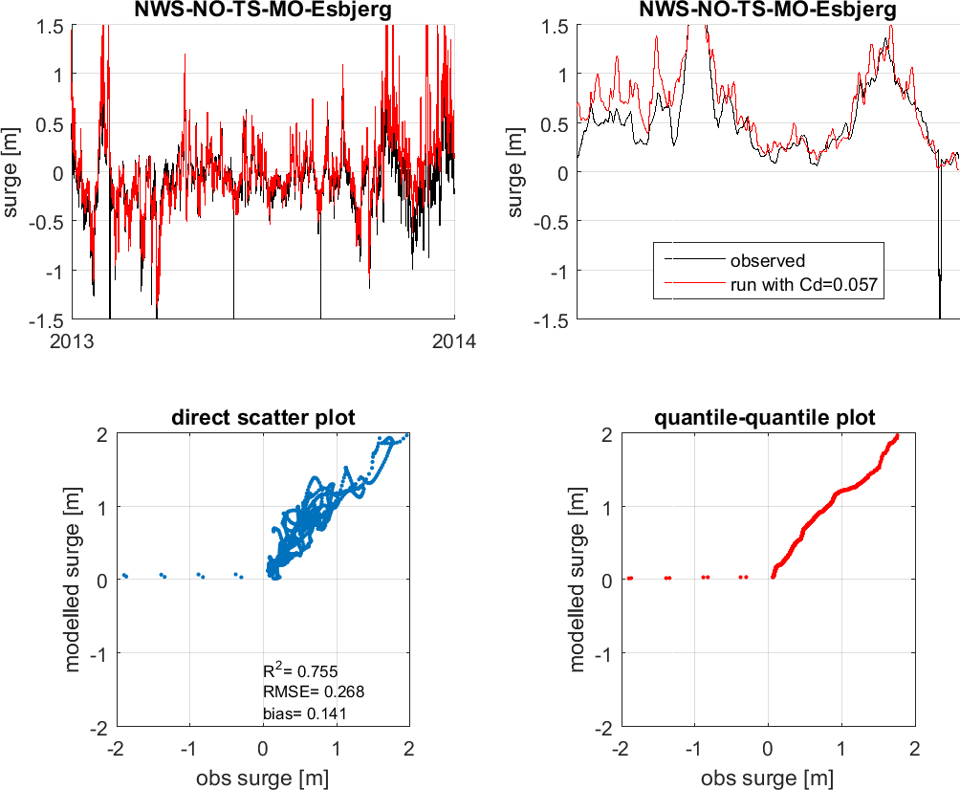
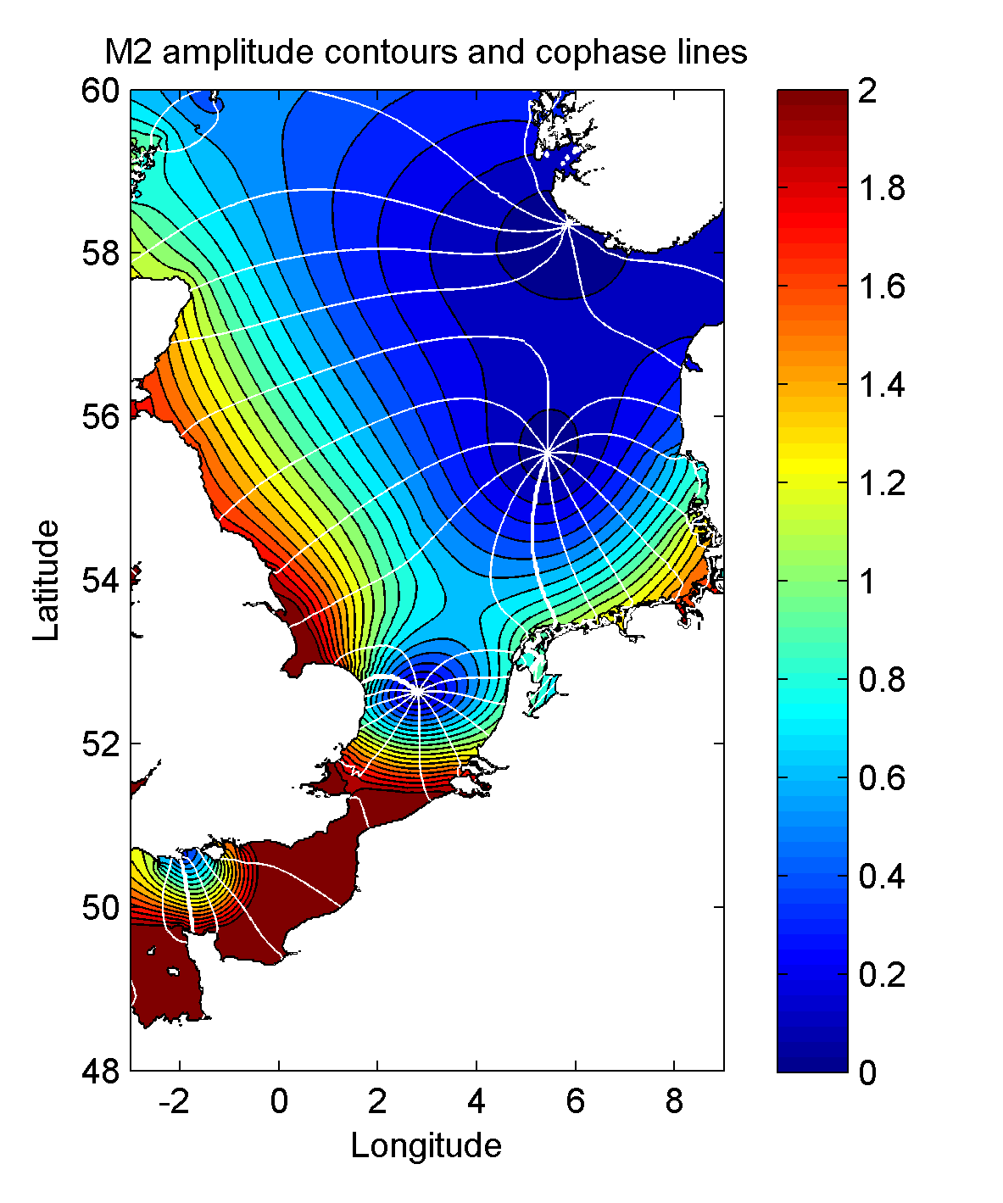
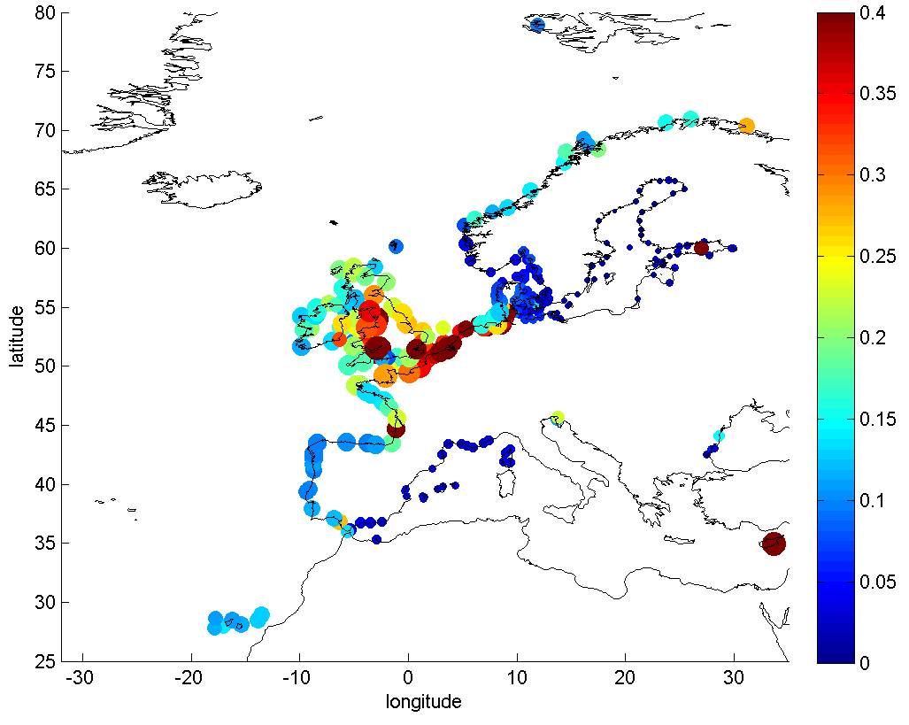
DATASETS: Water Levels North Sea use case
GTSMv3.0 @ tri max25km min1.25km, 1h vel, 10min elev
EMODnet ~250m (GEBCO 30arcsec&Bedmap2)
MSL-LAT correction with DCSMv6 (FES2012)
Model ECMWF IFS cycle 43r3
Barotropic, self attraction, loading, bottom friction stress, internal wave drag stress
Tidal potential, GCM / ERA5 winds and SLP @0.3$°$
WaterLevel, Astronomical Tide, Surge
Validation Surges 2012
Historical (1976-2005)
ERA5 (2001-2017)
RCP4.5 (2071-2100) + SLR
RCP8.5 (2041-2071) + SLR
Scheveningen, 1900
Princess Amalia Wind Farm
Notes:
MSL Mean Sea Level LAT lowest astronomical tide

Slide 7
MODELLING ACTIVITIES North Sea use case
                QUESTIONS?
  Mean Regime (every day loadings)
    Potential sediment transport?
    ‘Equilibrium’ shoreline orientation
    Port operability
    Potential wave and tidal power
    Navigation
    Tidal regulation
  Extreme Regime (exceptional loadings)
    Dune design
    Flooding protection (dunes, dikes,…)
    Overwash frequency
    Structural Design (ports, groynes, wind farms, …)
                PAST
                PRESENT
                FUTURE
Scheveningen, 1900
Princess Amalia Wind Farm
Pérez, J., Méndez, F. J., Menéndez, M., & Losada, I. J. (2014a). ESTELA: A method for evaluating the source and travel time of the wave energy reaching a local area. Ocean Dynamics, 64(8), 1181-1191. doi:DOI 10.1007/s10236-014-0740-7

Slide 8
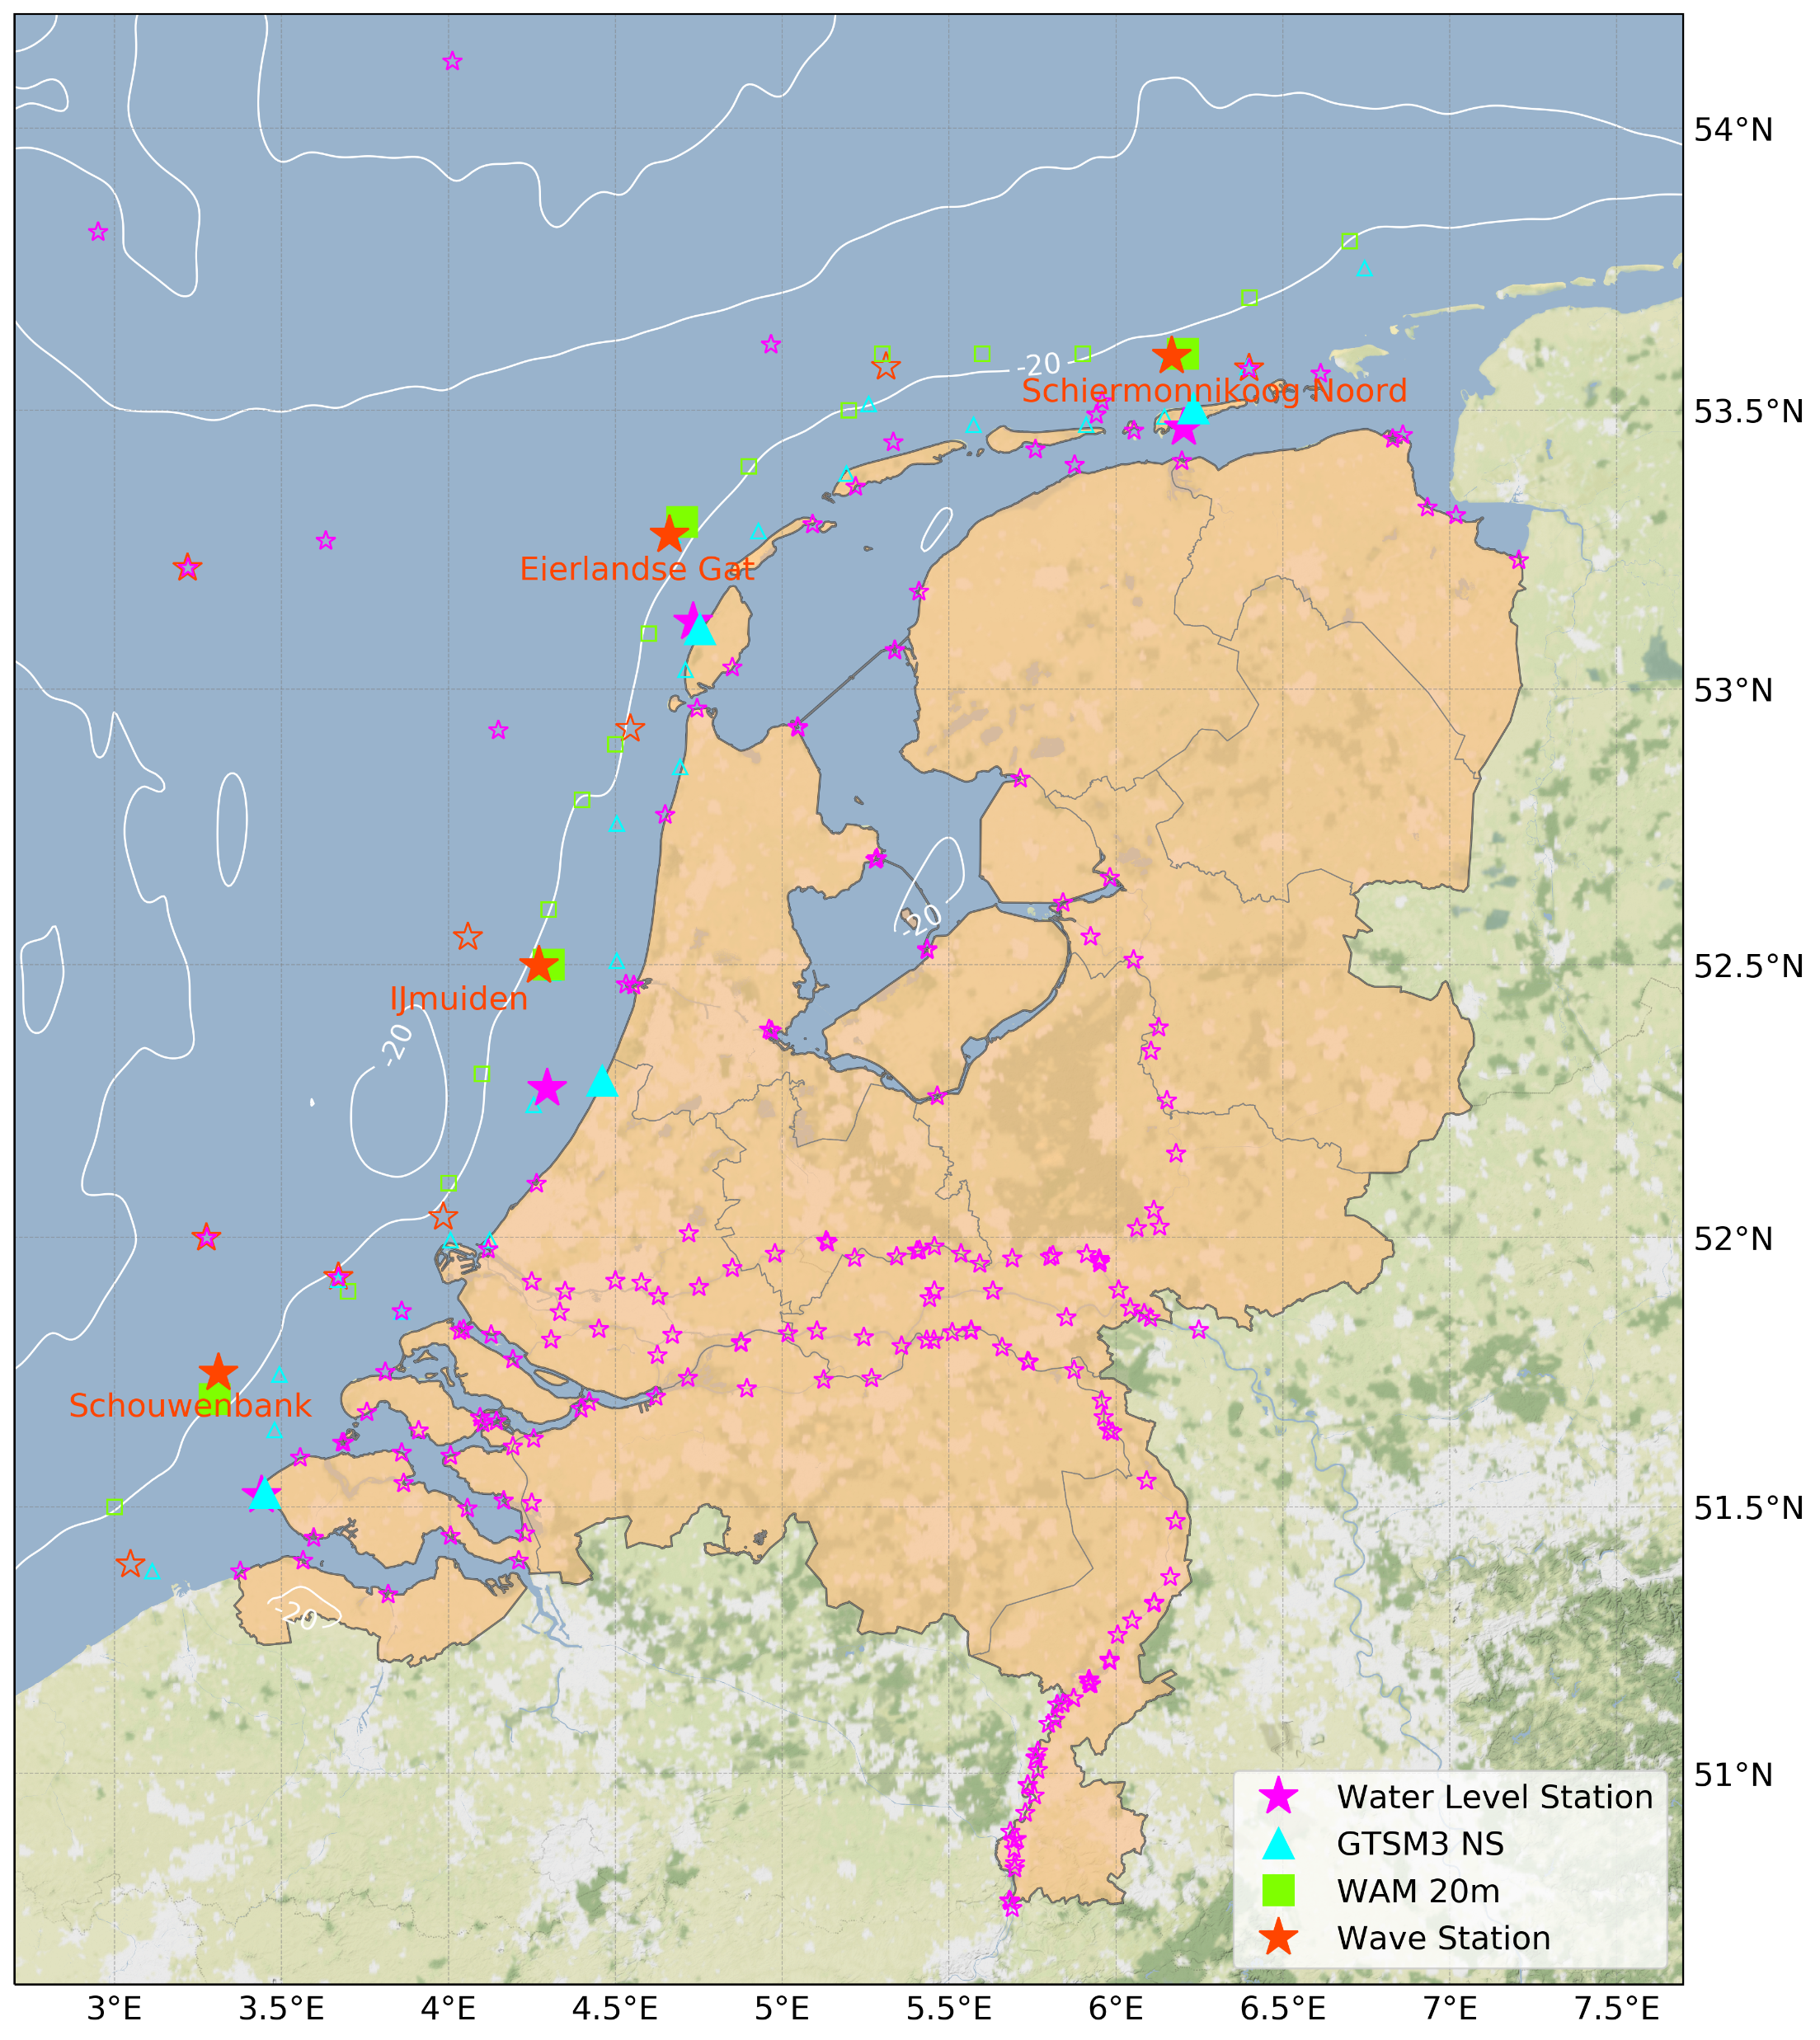
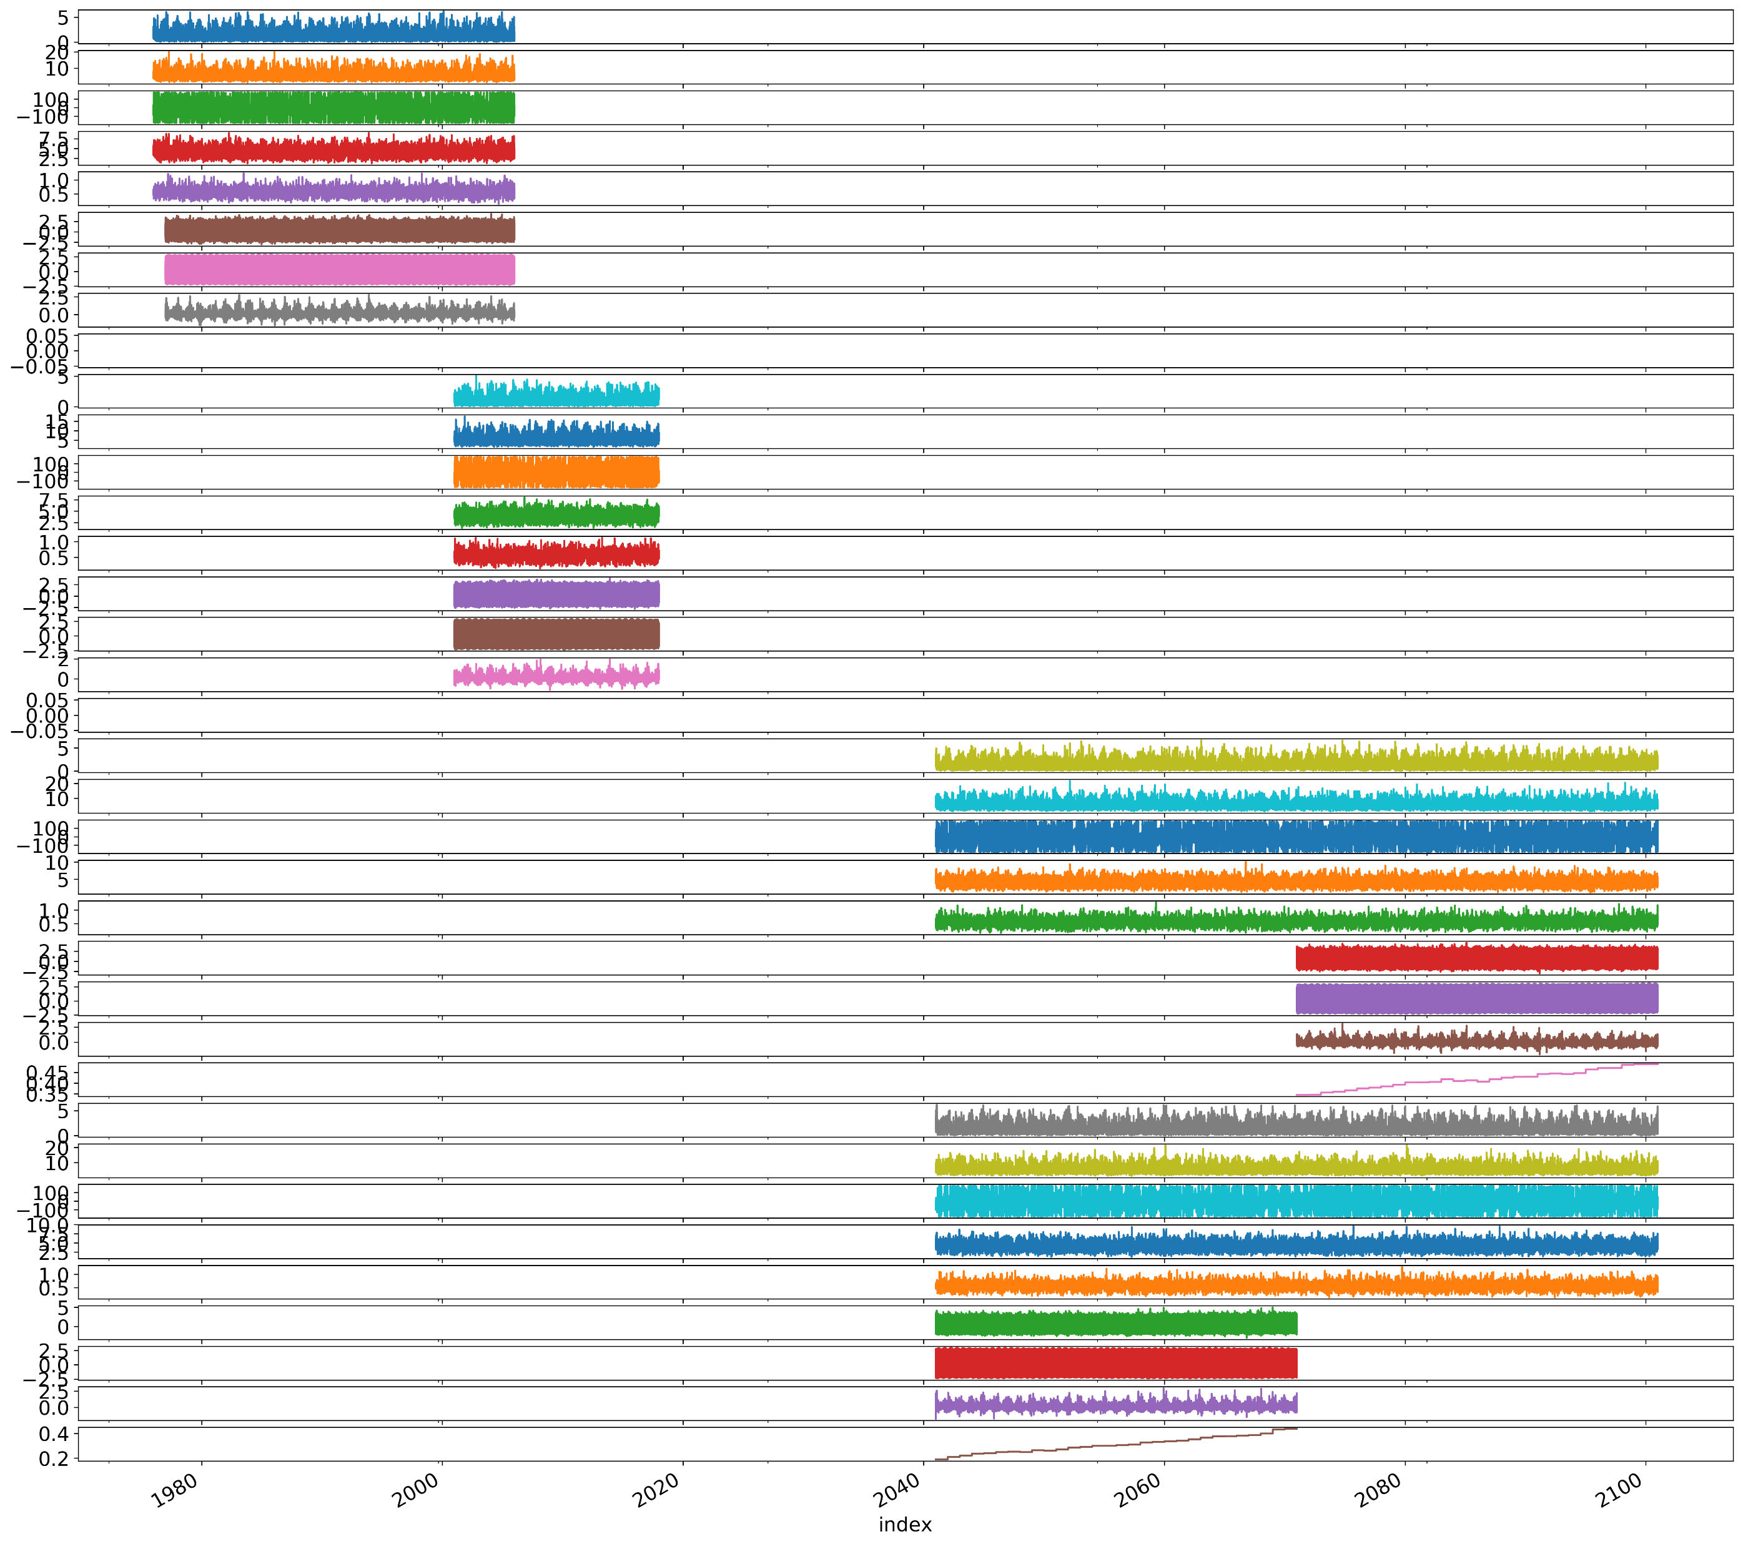
MODELLING ACTIVITIES North Sea use case
2001
1976
2005
2041
2071
2100
SWH
PP1D
MWD
MP1
WDW
WL
AT
SS
SWH
PP1D
MWD
MP1
WDW
WL
AT
SS
SLR
Scheveningen, 1900
1976
2005
2071
2001
2041
2100
Princess Amalia Wind Farm

Slide 9
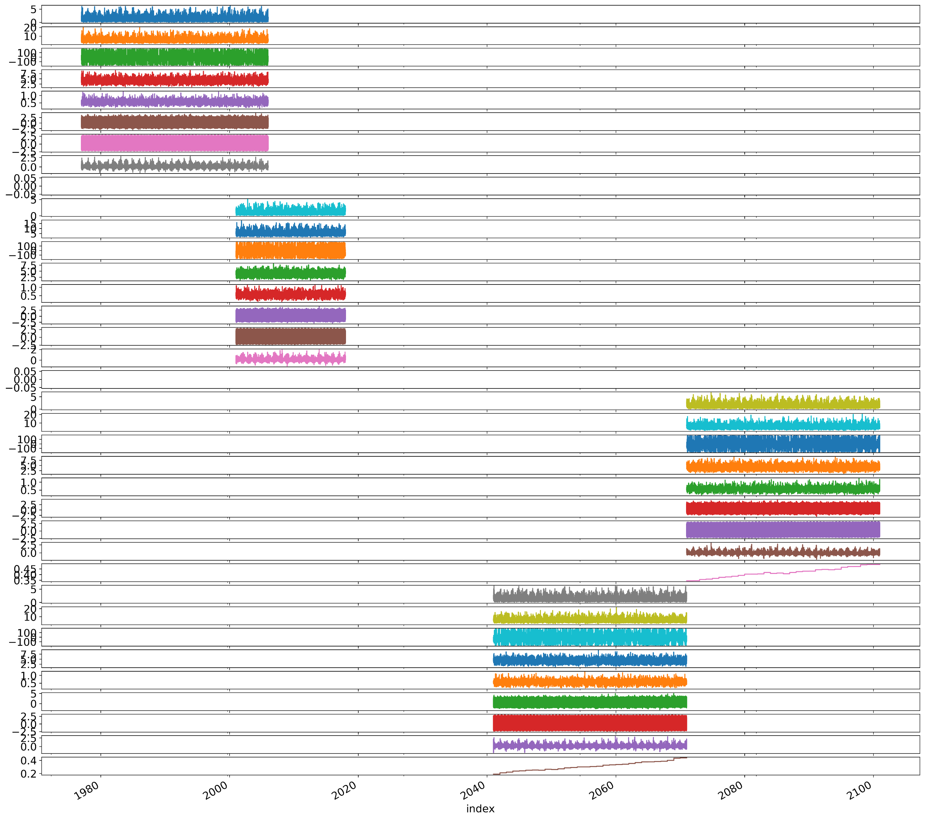
MODELLING ACTIVITIES North Sea use case
1977
hist
2005
2071
RCP45
2100
2001
ERA5
2017
2041
RCP85
2070
Scheveningen, 1900
Princess Amalia Wind Farm

Slide 10
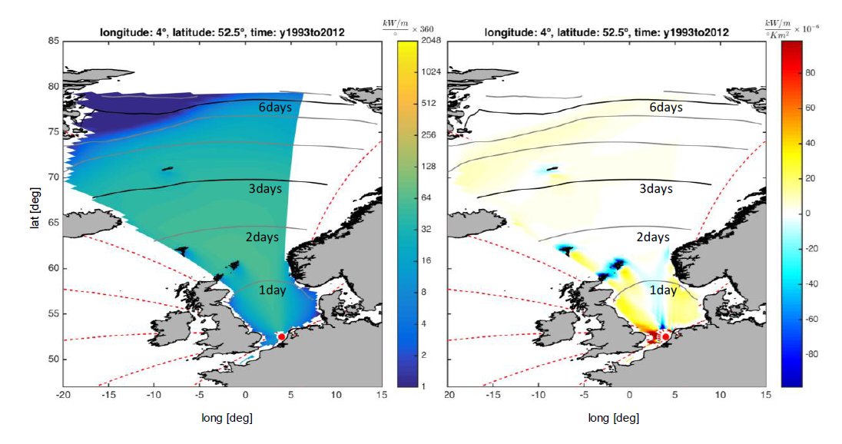
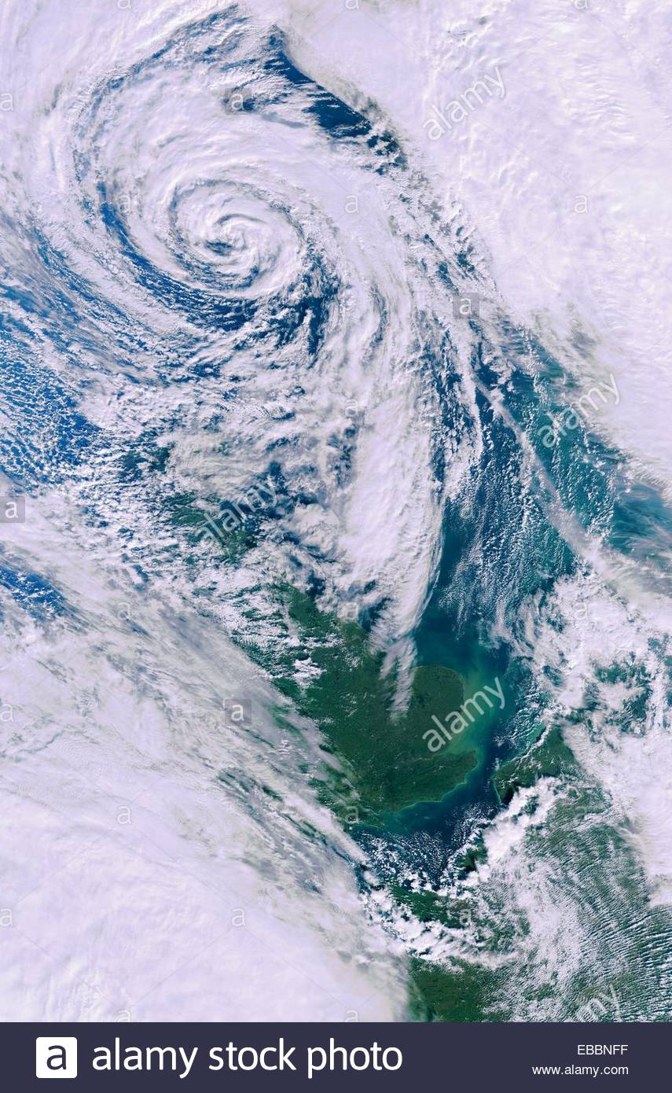
MODELLING ACTIVITIES North Sea use case
Wave Energy source area and characteristic travel times for Noordwijk
(Tu Delft MSc Thesis Carlos Rozas, following Estela, Pérez et al. 2014)
Scheveningen, 1900
Princess Amalia Wind Farm
Pérez, J., Méndez, F. J., Menéndez, M., & Losada, I. J. (2014a). ESTELA: A method for evaluating the source and travel time of the wave energy reaching a local area. Ocean Dynamics, 64(8), 1181-1191. doi:DOI 10.1007/s10236-014-0740-7

Slide 11
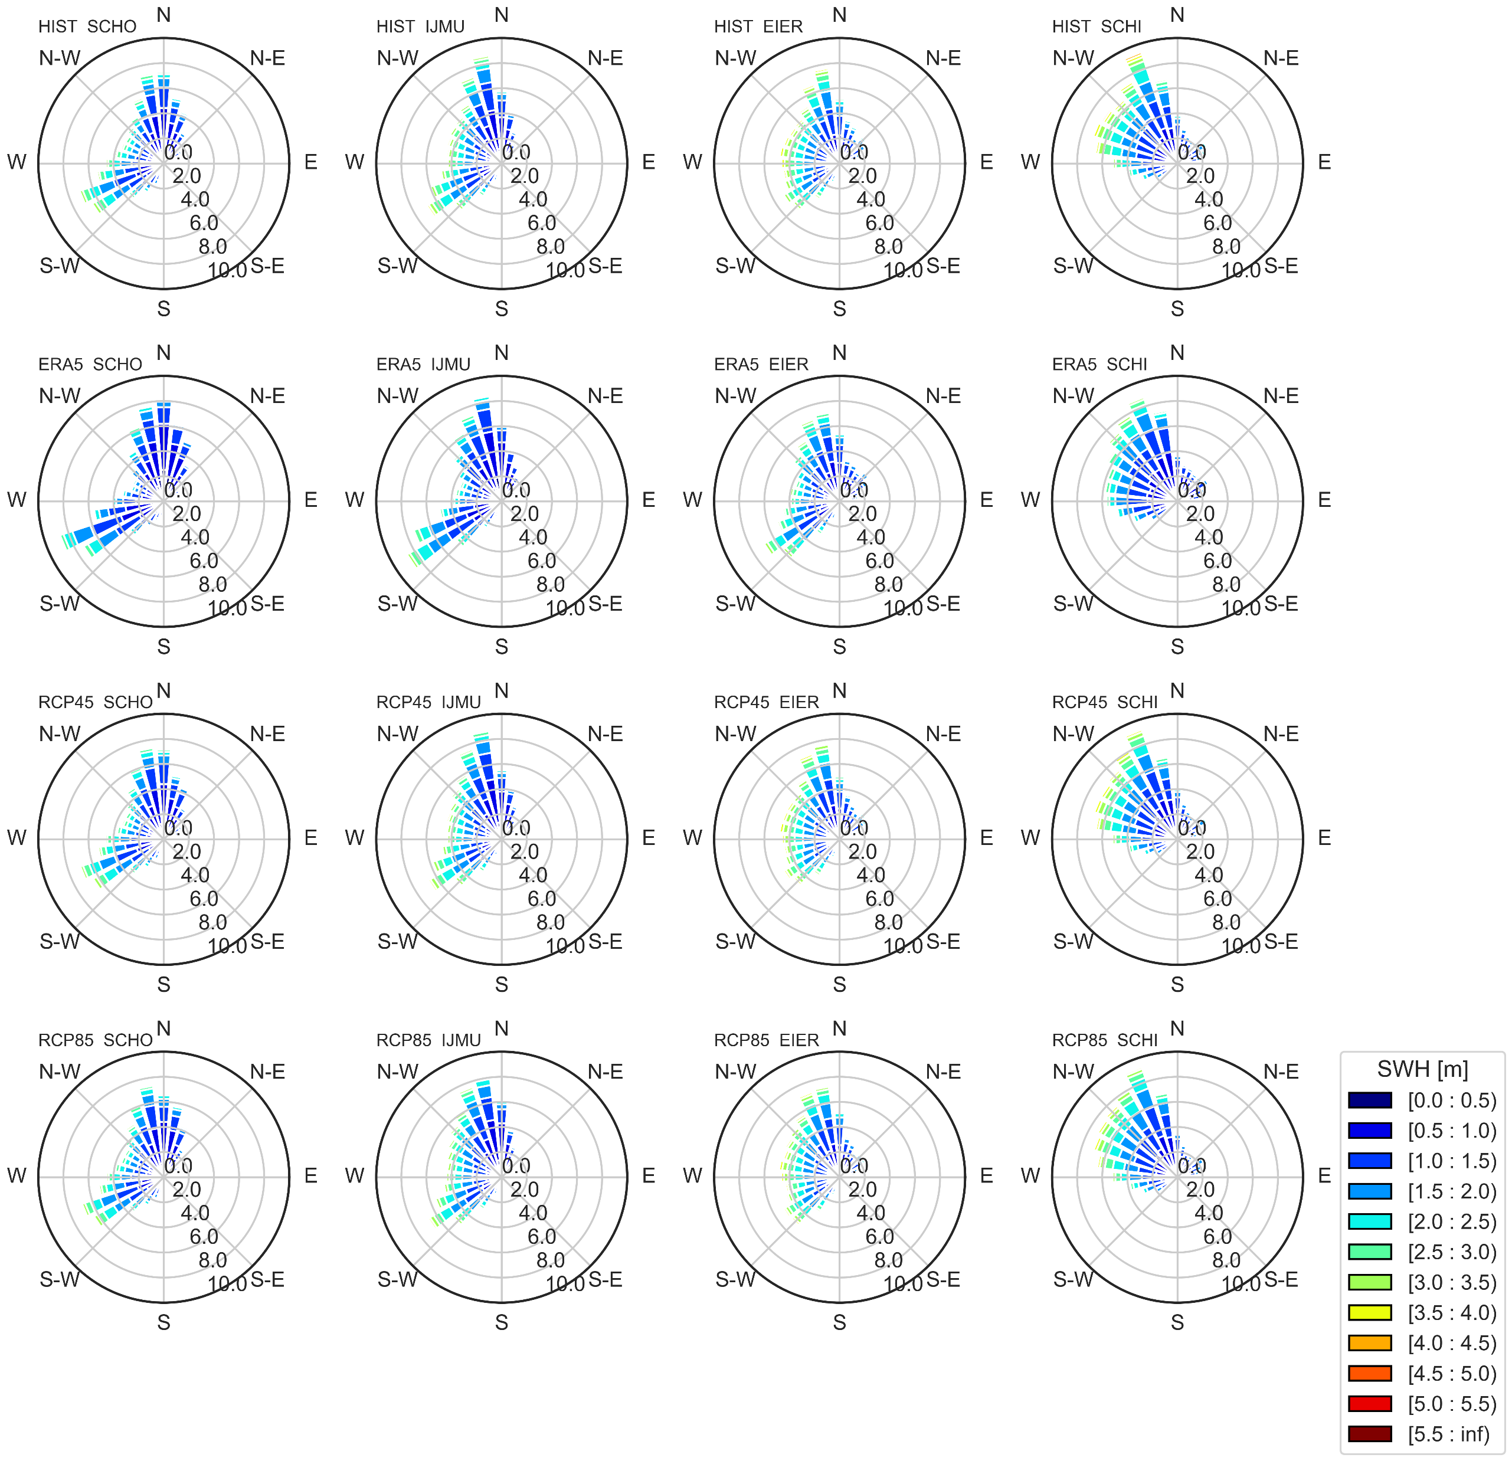
MODELLING ACTIVITIES North Sea use case
SCHO
IJMU
EIER
SCHI
Historical
(1976-2005)
ERA5
(2001-2017)
SWH
RCP4.5
(2071-2100)
Scheveningen, 1900
RCP8.5
(2041-2071)
Princess Amalia Wind Farm

Slide 12
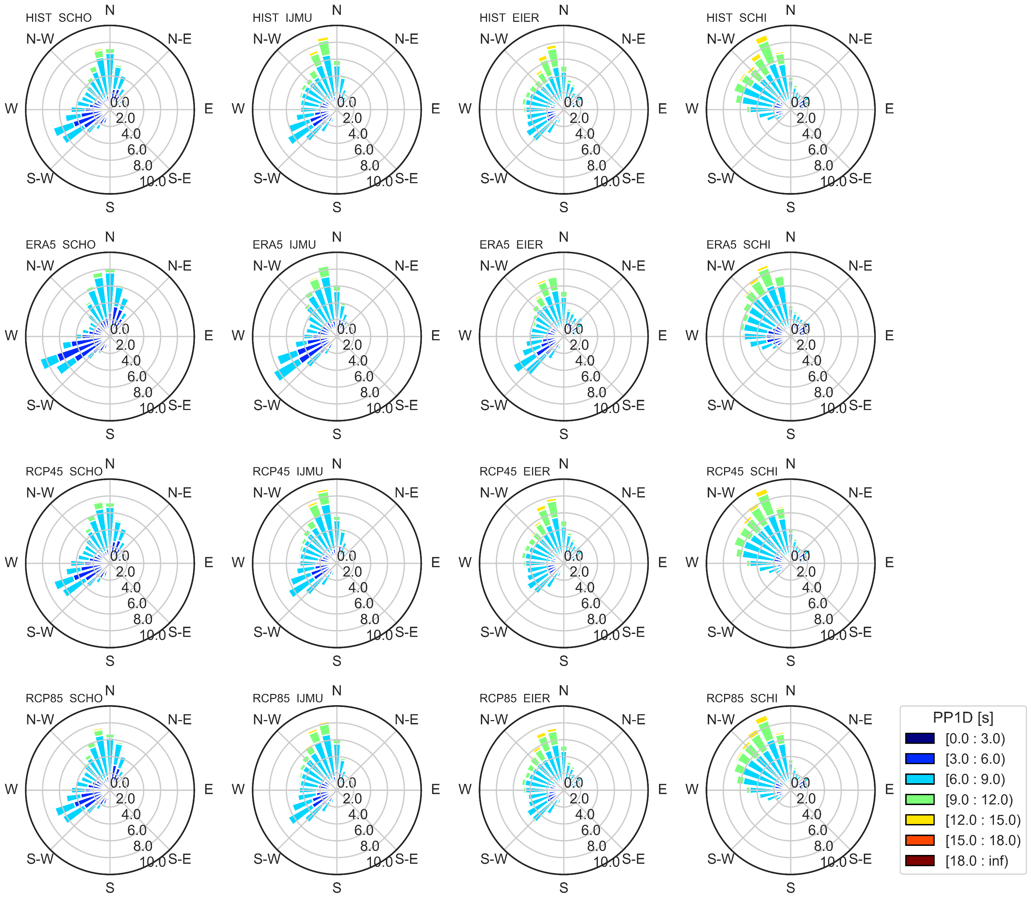
MODELLING ACTIVITIES North Sea use case
SCHO
IJMU
EIER
SCHI
Historical
(1976-2005)
ERA5
(2001-2017)
SWH
RCP4.5
(2071-2100)
Scheveningen, 1900
RCP8.5
(2041-2071)
Princess Amalia Wind Farm

Slide 13
MODELLING ACTIVITIES North Sea use case
SCHO
IJMU
EIER
SCHI
Historical (1976-2005)
PP1D
ERA5 (2001-2017)
RCP4.5 (2071-2100)
Scheveningen, 1900
RCP8.5 (2041-2071)

Slide 14
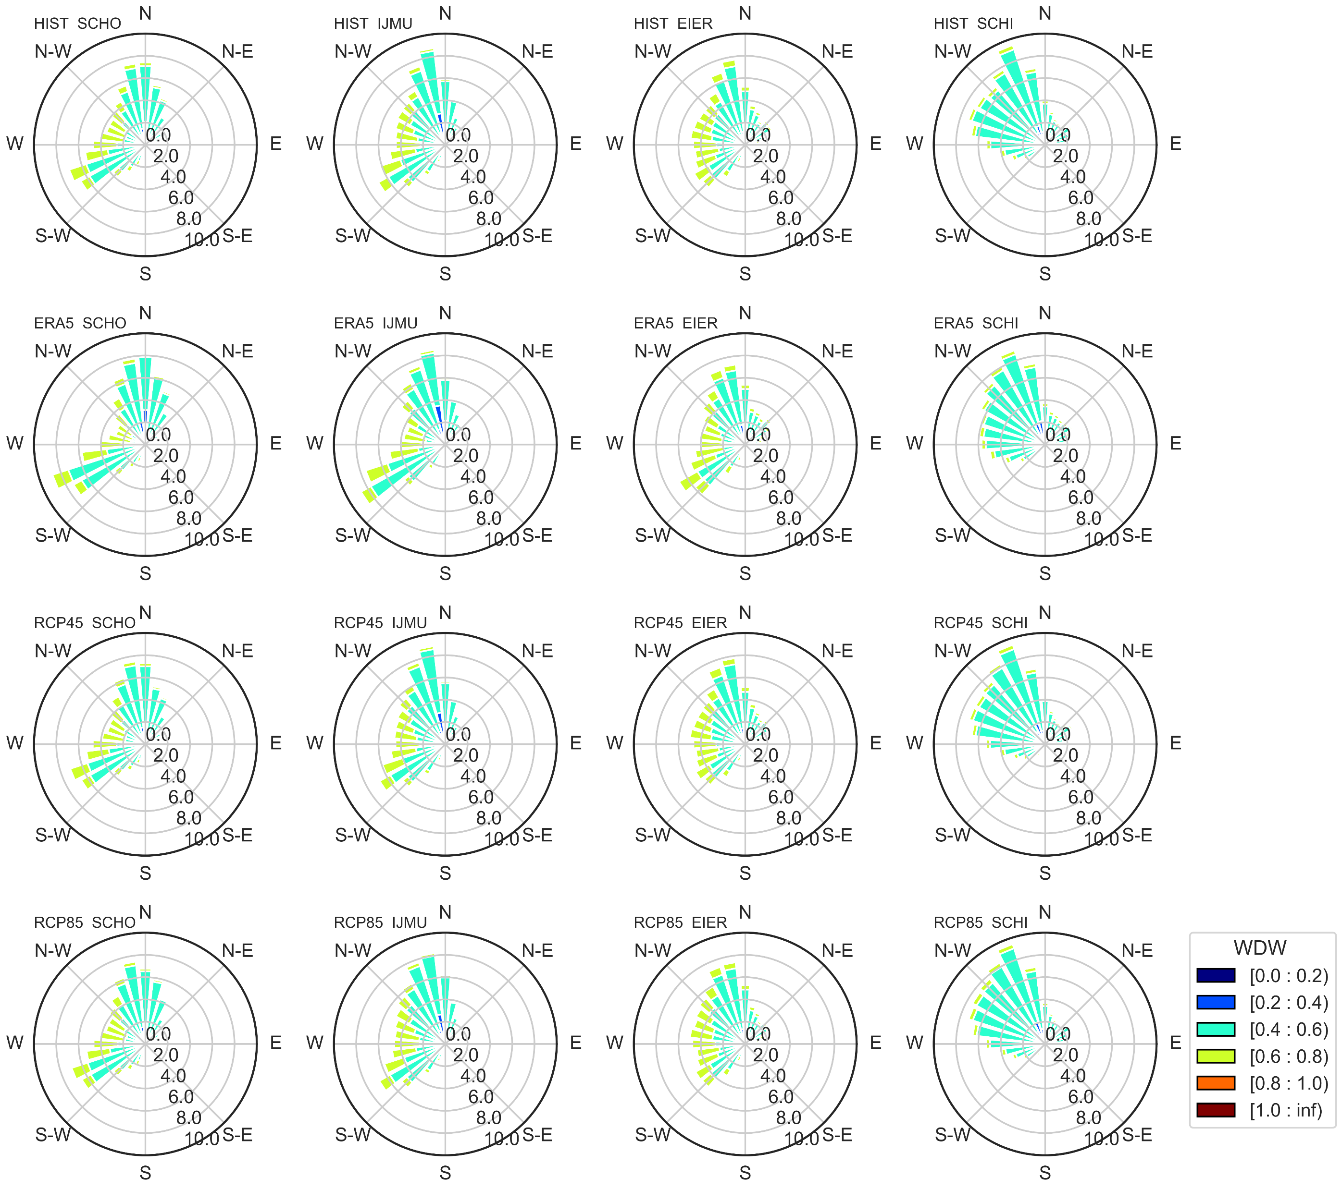
MODELLING ACTIVITIES North Sea use case
SCHO
IJMU
EIER
SCHI
Historical (1976-2005)
WWDW
ERA5 (2001-2017)
RCP4.5 (2071-2100)
RCP8.5 (2041-2071)

Slide 15
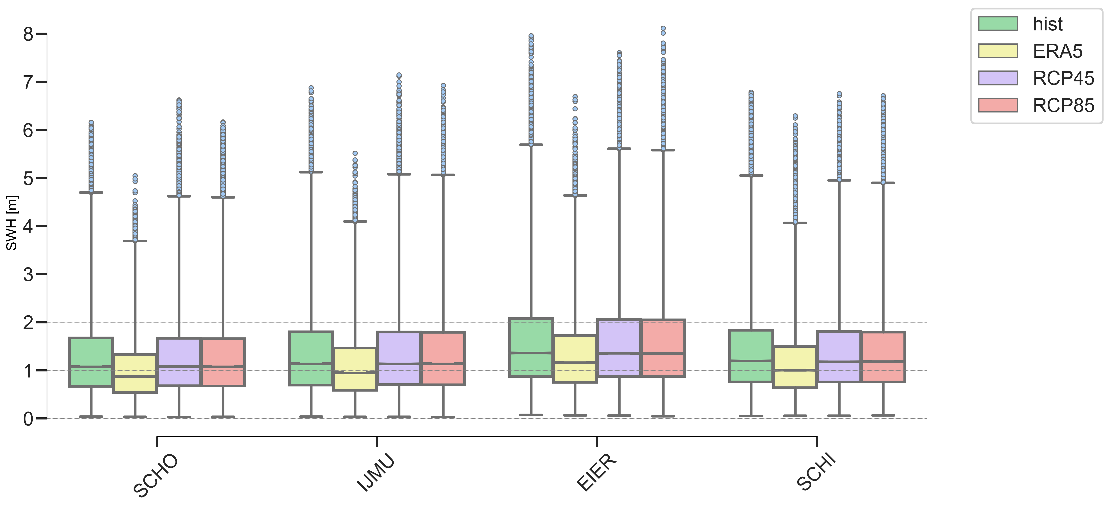
MODELLING ACTIVITIES North Sea use case
SWH
Princess Amalia Wind Farm

Slide 16
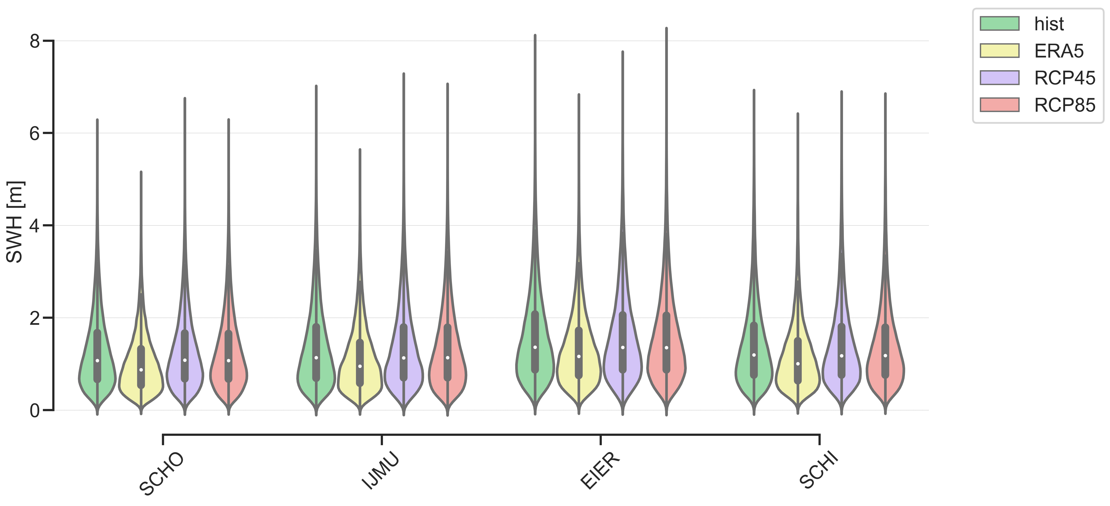
MODELLING ACTIVITIES North Sea use case
SWH
Princess Amalia Wind Farm

Slide 17
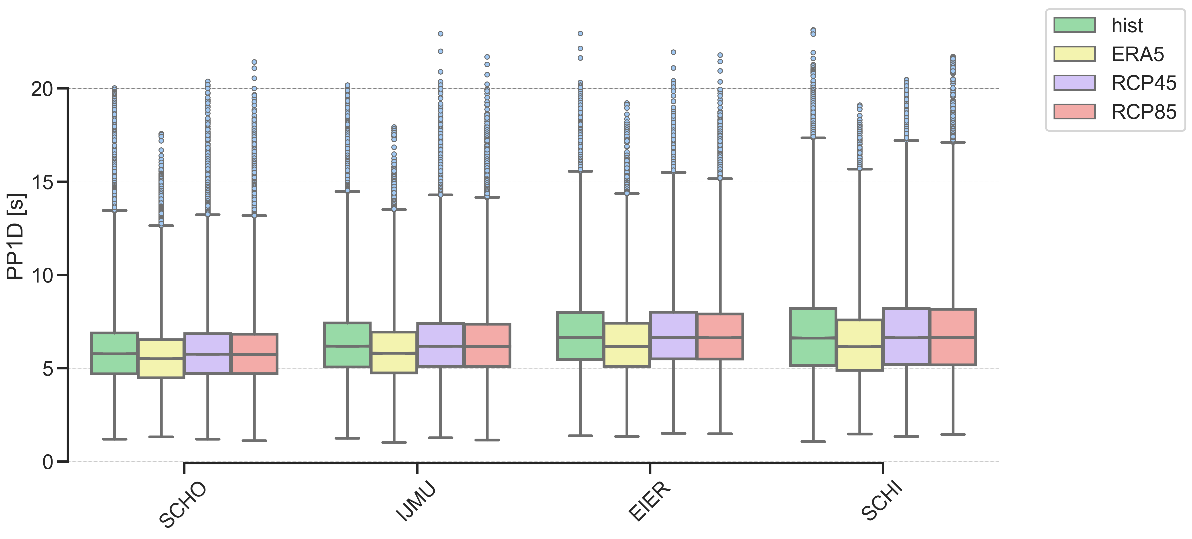
MODELLING ACTIVITIES North Sea use case
PP1D
Princess Amalia Wind Farm

Slide 18
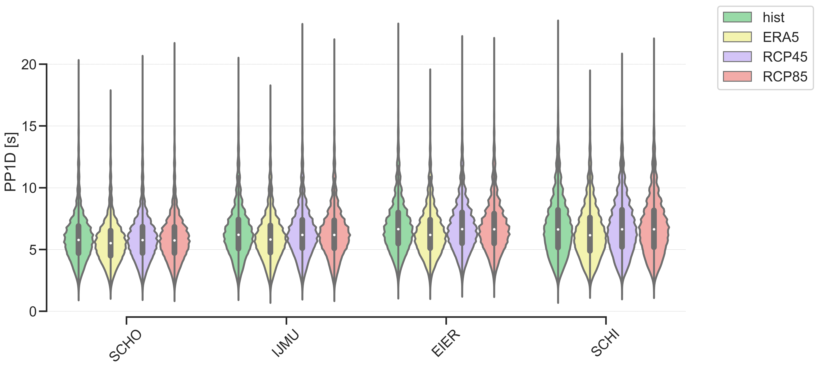
MODELLING ACTIVITIES North Sea use case
PP1D
Princess Amalia Wind Farm

Slide 19
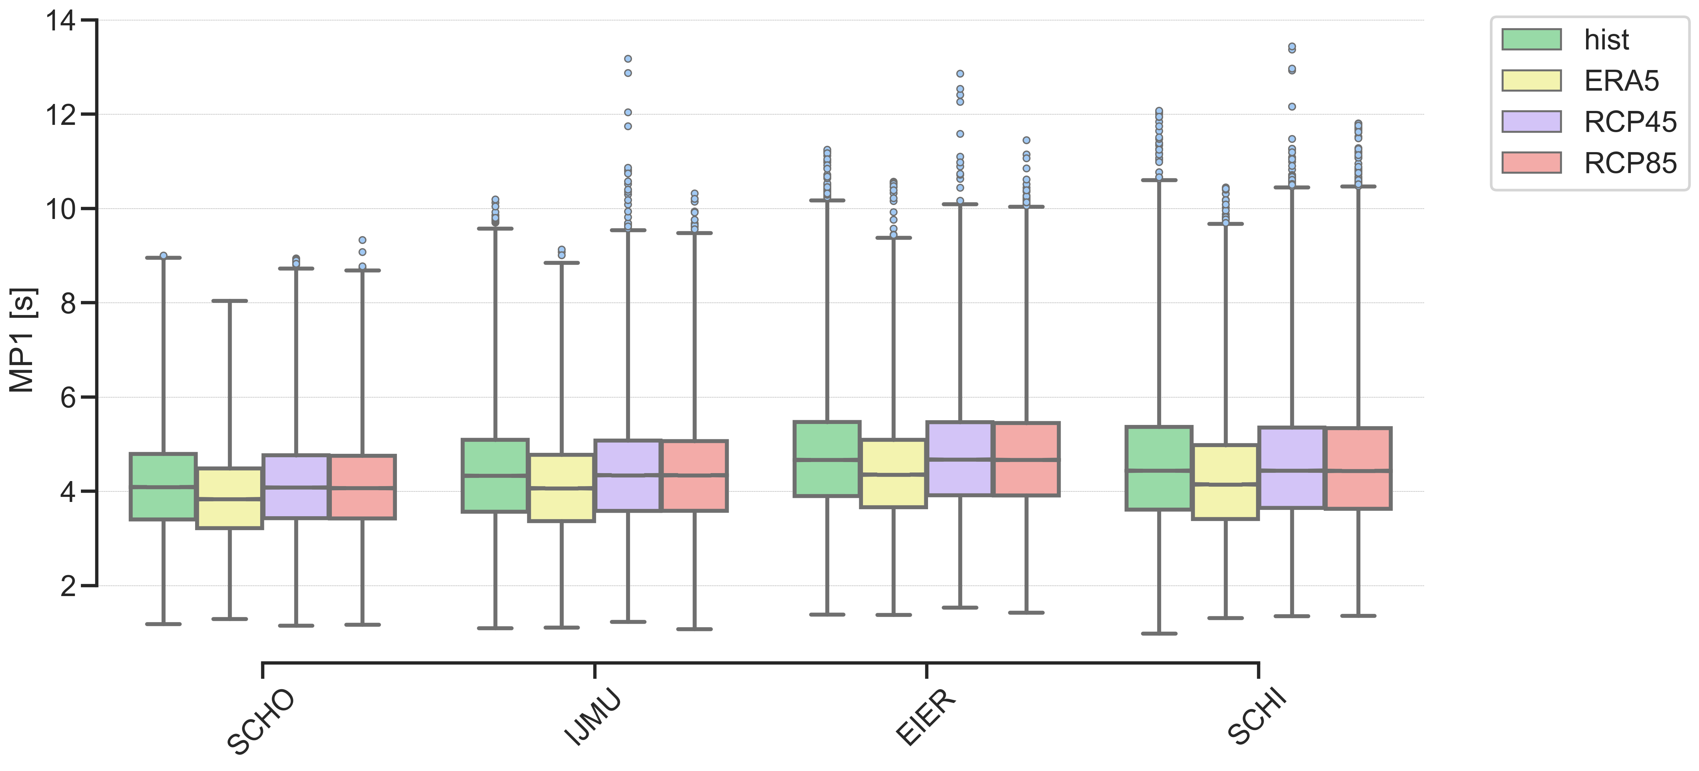
MODELLING ACTIVITIES North Sea use case
MP1
Princess Amalia Wind Farm

Slide 20
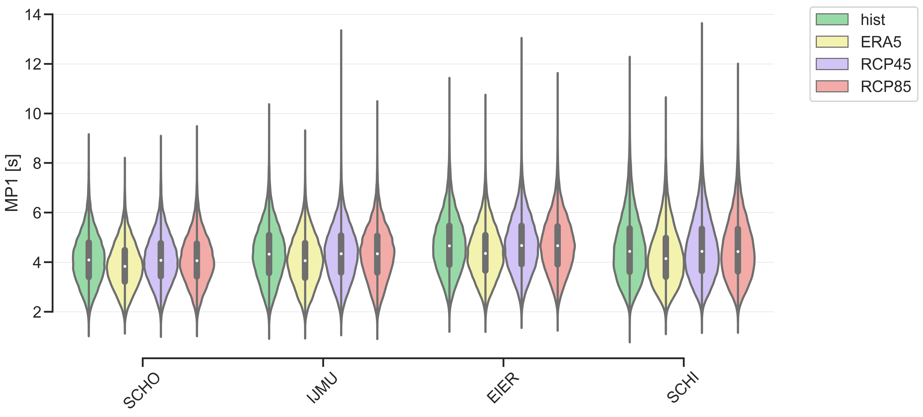
MODELLING ACTIVITIES North Sea use case
MP1
Princess Amalia Wind Farm

Slide 21
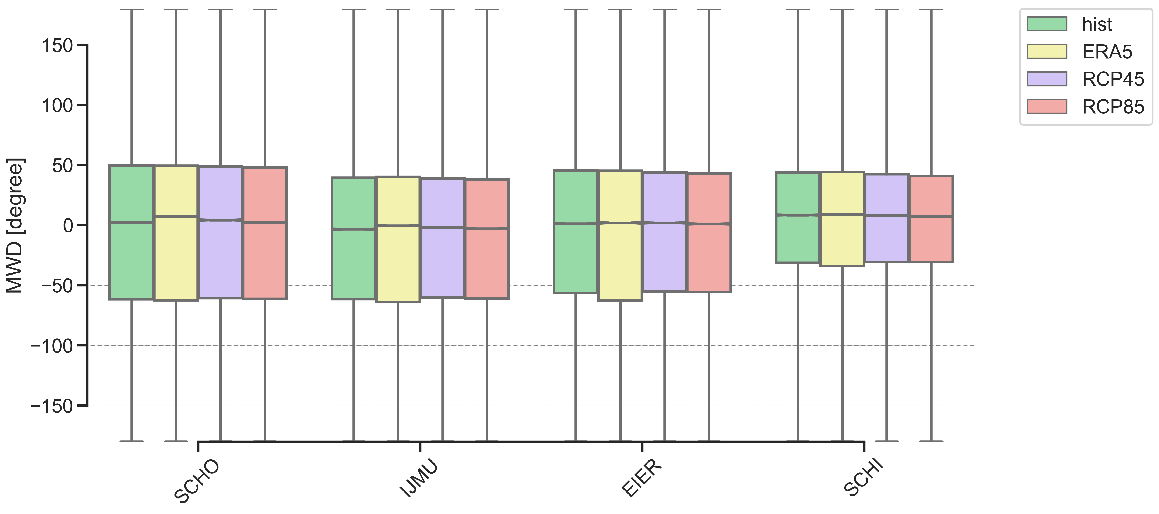
MODELLING ACTIVITIES North Sea use case
MWD
HIST mean : 311.89$°$
Princess Amalia Wind Farm

Slide 22
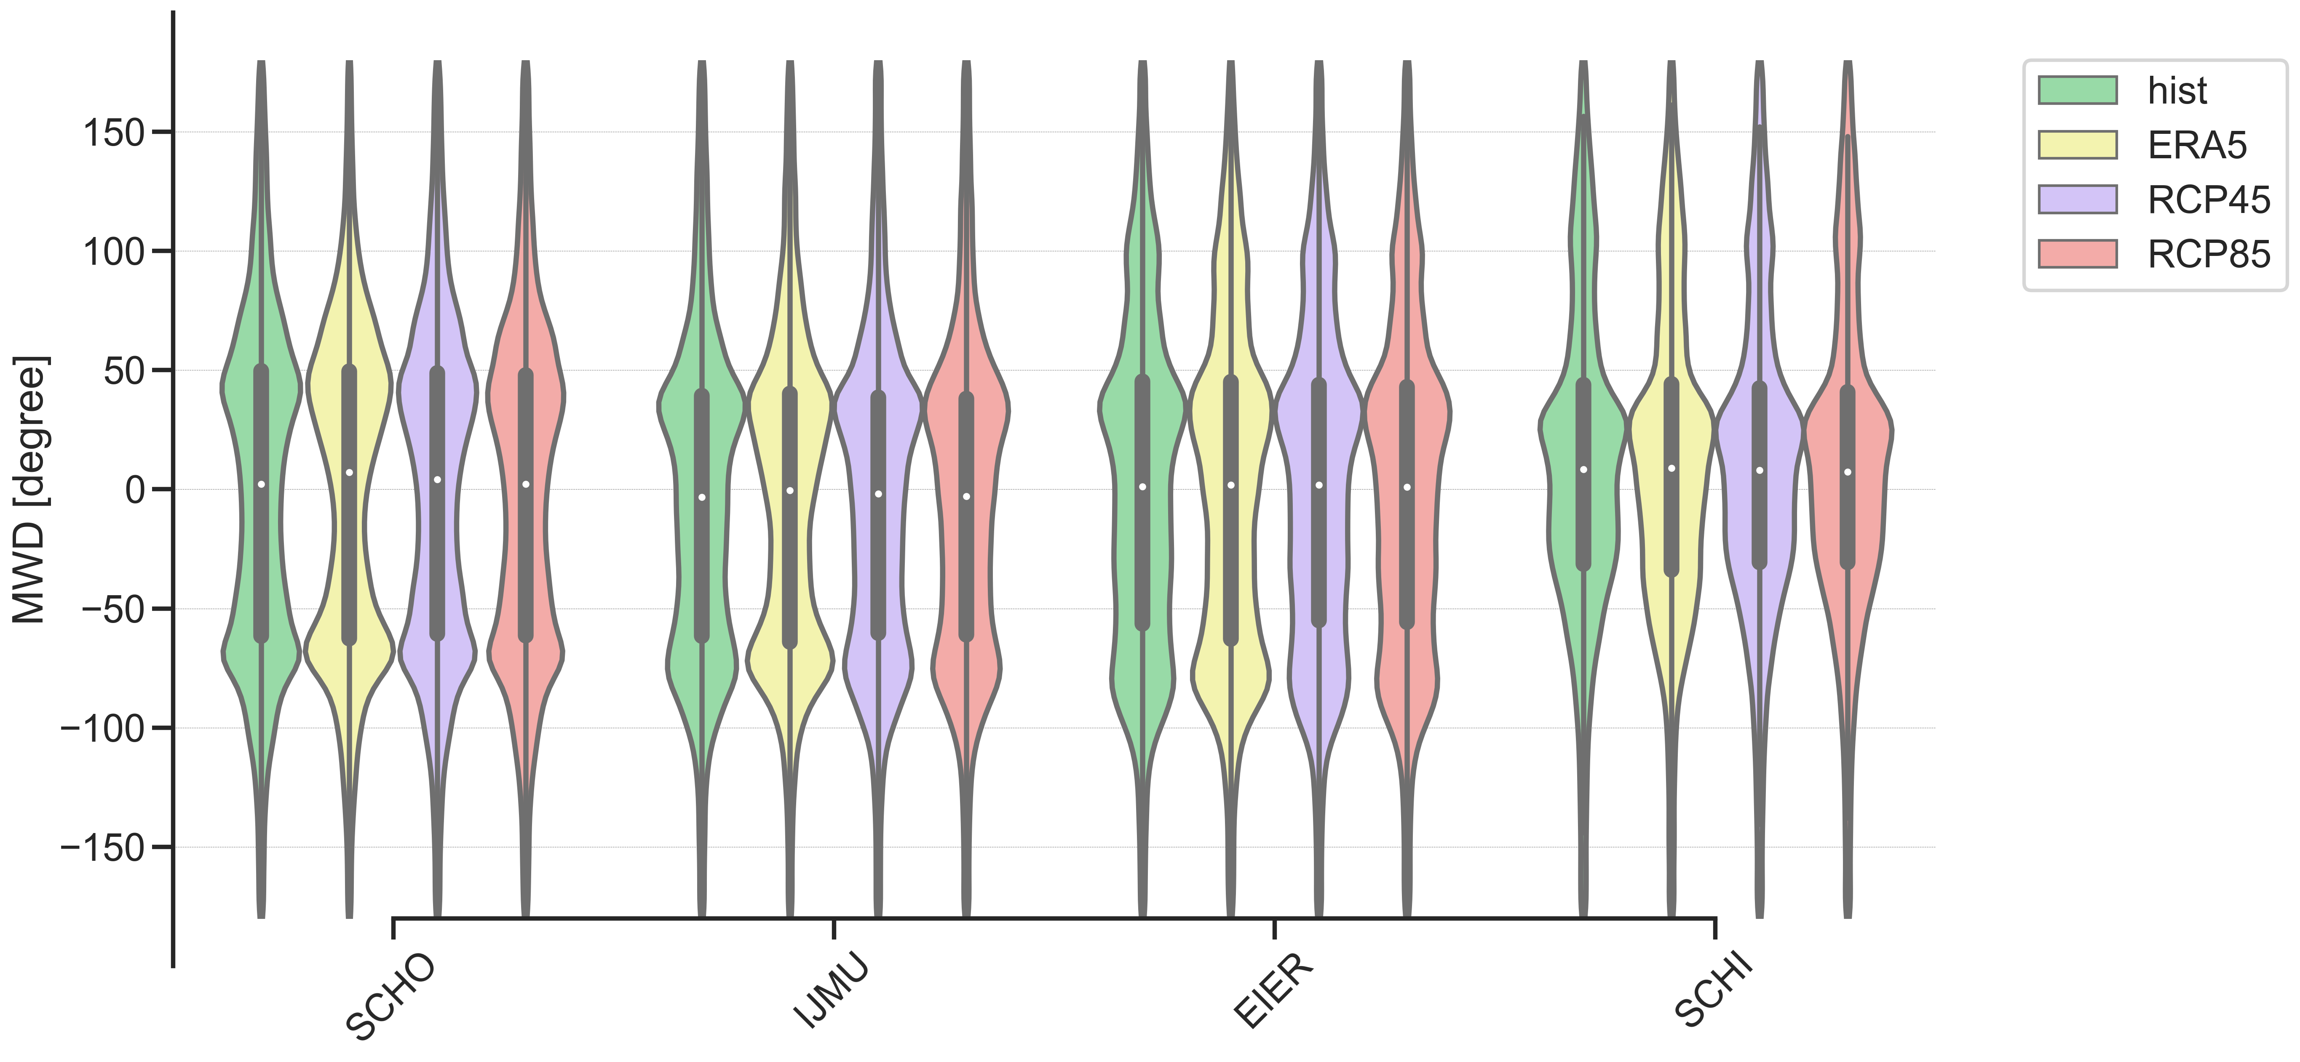
MODELLING ACTIVITIES North Sea use case
MWD
311
HIST mean : 311.89$°$
Princess Amalia Wind Farm

Slide 23
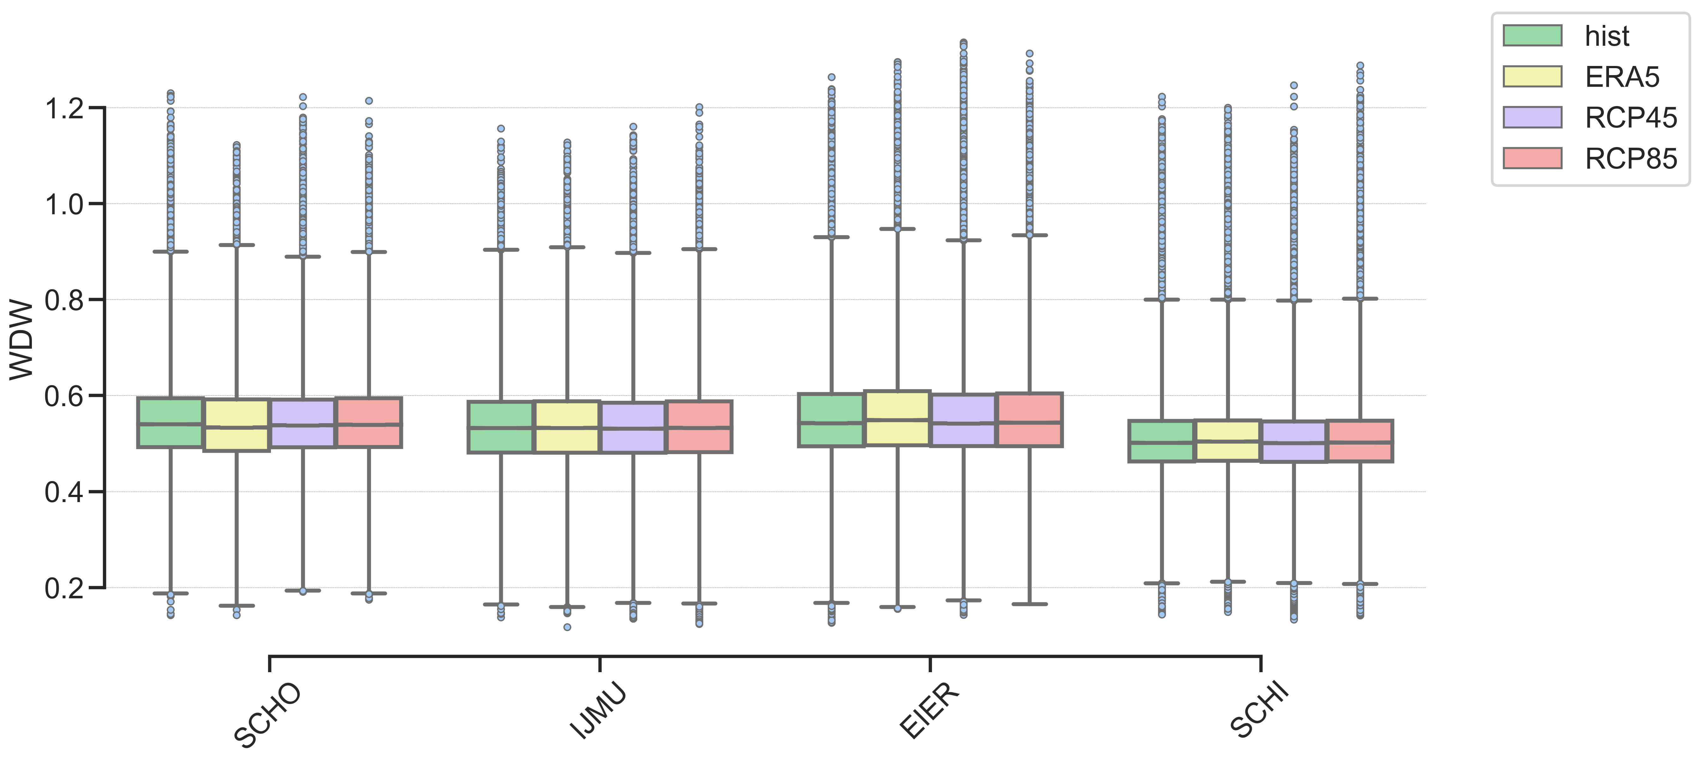
MODELLING ACTIVITIES North Sea use case
WDW
Princess Amalia Wind Farm

Slide 24
MODELLING ACTIVITIES North Sea use case
WDW
Princess Amalia Wind Farm

Slide 25
MODELLING ACTIVITIES North Sea use case
WL
Princess Amalia Wind Farm

Slide 26
MODELLING ACTIVITIES North Sea use case
WL
Princess Amalia Wind Farm

Slide 27
MODELLING ACTIVITIES North Sea use case
AT
Princess Amalia Wind Farm

Slide 28
MODELLING ACTIVITIES North Sea use case
AT
Princess Amalia Wind Farm

Slide 29
MODELLING ACTIVITIES North Sea use case
SS
Princess Amalia Wind Farm

Slide 30
MODELLING ACTIVITIES North Sea use case
SS
Princess Amalia Wind Farm

Slide 31
MODELLING ACTIVITIES North Sea use case
SWH
SCHI
Princess Amalia Wind Farm

Slide 32
MODELLING ACTIVITIES North Sea use case
MWD
EIER
311
Princess Amalia Wind Farm

Slide 33
MODELLING ACTIVITIES North Sea use case
SS
SCHO
Princess Amalia Wind Farm

Slide 34
MODELLING ACTIVITIES North Sea use case
SS
SCHO
Princess Amalia Wind Farm

Slide 35
MODELLING ACTIVITIES North Sea use case
SS
SCHI
Princess Amalia Wind Farm

Slide 36
MODELLING ACTIVITIES North Sea use case
SS
SCHI
Princess Amalia Wind Farm

Slide 37
MODELLING ACTIVITIES North Sea use case
 | WP | MWD
hist | -0.01603 | -0.11769
ERA5 | -0.03089 | -0.64135
RCP45 | -0.1012 | 0.230453
RCP85 | -0.00498 | 0.347085
Annual mean Wave Direction
Annual mean Wave Power = SWH²*MP1
Princess Amalia Wind Farm

Slide 38
MODELLING ACTIVITIES North Sea use case
Annual mean Storm Surge
Annual mean Storm Surge
Sea Level Rise
Sea Level Rise
 | WL | SS
hist | 0.000482 | 0.000466
ERA5 | 0.00028 | 0.000339
RCP45 | 0.003181 | -0.00558
RCP85 | 0.007172 | -0.00014
Annual mean Water Level
Annual mean Water Level
Princess Amalia Wind Farm

Slide 39
MODELLING ACTIVITIES North Sea use case
Annual mean Storm Surge
Sea Level Rise
 | WL | SS
hist | 0.000482 | 0.000466
ERA5 | 0.00028 | 0.000339
RCP45 | 0.003181 | -0.001147
RCP85 | 0.007172 | -0.00014
Annual mean Water Level
Princess Amalia Wind Farm

Slide 40
MODELLING ACTIVITIES North Sea use case
Historical (1976-2005)
ERA5 (2001-2017)
pos | SCHO
params | SWH | PP1D | MWD | MP1 | WDW | WL | AT | SS
SWH | 1 | 0.478095 | 0.135271 | 0.764934 | -0.15036 | 0.087398 | 0.001016 | 0.437035
PP1D | 0.478095 | 1 | 0.300091 | 0.793723 | -0.48521 | 0.059515 | -0.00101 | 0.271194
MWD | 0.135271 | 0.300091 | 1 | 0.349996 | 0.040081 | 0.065422 | 0.000709 | 0.343602
MP1 | 0.764934 | 0.793723 | 0.349996 | 1 | -0.43826 | 0.084526 | 0.002374 | 0.394514
WDW | -0.15036 | -0.48521 | 0.040081 | -0.43826 | 1 | 0.019203 | 0.005035 | 0.108337
WL | 0.087398 | 0.059515 | 0.065422 | 0.084526 | 0.019203 | 1 | 0.977846 | 0.155439
AT | 0.001016 | -0.00101 | 0.000709 | 0.002374 | 0.005035 | 0.977846 | 1 | -0.02912
SS | 0.437035 | 0.271194 | 0.343602 | 0.394514 | 0.108337 | 0.155439 | -0.02912 | 1
pos | SCHO
params | SWH | PP1D | MWD | MP1 | WDW | WL | AT | SS
SWH | 1 | 0.3965 | 0.116076 | 0.702507 | -0.06661 | 0.06238 | 0.000151 | 0.398129
PP1D | 0.3965 | 1 | 0.263951 | 0.766566 | -0.49599 | 0.030831 | -0.0005 | 0.157597
MWD | 0.116076 | 0.263951 | 1 | 0.328532 | 0.060761 | 0.045266 | 0.003174 | 0.285794
MP1 | 0.702507 | 0.766566 | 0.328532 | 1 | -0.4228 | 0.052402 | 0.001244 | 0.299146
WDW | -0.06661 | -0.49599 | 0.060761 | -0.4228 | 1 | 0.027051 | 0.003155 | 0.196454
WL | 0.06238 | 0.030831 | 0.045266 | 0.052402 | 0.027051 | 1 | 0.987079 | 0.107009
AT | 0.000151 | -0.0005 | 0.003174 | 0.001244 | 0.003155 | 0.987079 | 1 | -0.03486
SS | 0.398129 | 0.157597 | 0.285794 | 0.299146 | 0.196454 | 0.107009 | -0.03486 | 1
pos | SCHO
params | SWH | PP1D | MWD | MP1 | WDW | WL | AT | SS
SWH | 1 | 0.477634 | 0.122289 | 0.762191 | -0.12187 | 0.083199 | -0.00412 | 0.436135
PP1D | 0.477634 | 1 | 0.321991 | 0.800901 | -0.4846 | 0.05859 | -0.00229 | 0.272478
MWD | 0.122289 | 0.321991 | 1 | 0.36129 | 0.013024 | 0.058928 | -0.00214 | 0.318785
MP1 | 0.762191 | 0.800901 | 0.36129 | 1 | -0.41773 | 0.08036 | -0.00237 | 0.395346
WDW | -0.12187 | -0.4846 | 0.013024 | -0.41773 | 1 | 0.021495 | 0.007663 | 0.094287
WL | 0.083199 | 0.05859 | 0.058928 | 0.08036 | 0.021495 | 1 | 0.978178 | 0.118378
AT | -0.00412 | -0.00229 | -0.00214 | -0.00237 | 0.007663 | 0.978178 | 1 | -0.0648
SS | 0.436135 | 0.272478 | 0.318785 | 0.395346 | 0.094287 | 0.118378 | -0.0648 | 1
pos | SCHO
params | SWH | PP1D | MWD | MP1 | WDW | WL | AT | SS
SWH | 1 | 0.48282 | 0.145121 | 0.765286 | -0.11796 | 0.085128 | -0.0019 | 0.442515
PP1D | 0.48282 | 1 | 0.33741 | 0.799997 | -0.47874 | 0.063424 | 0.002036 | 0.284692
MWD | 0.145121 | 0.33741 | 1 | 0.375036 | 0.017971 | 0.061481 | 6.92E-05 | 0.33668
MP1 | 0.765286 | 0.799997 | 0.375036 | 1 | -0.41486 | 0.083517 | 0.000319 | 0.408091
WDW | -0.11796 | -0.47874 | 0.017971 | -0.41486 | 1 | 0.016031 | 0.003277 | 0.098968
WL | 0.085128 | 0.063424 | 0.061481 | 0.083517 | 0.016031 | 1 | 0.977232 | 0.146437
AT | -0.0019 | 0.002036 | 6.92E-05 | 0.000319 | 0.003277 | 0.977232 | 1 | -0.03664
SS | 0.442515 | 0.284692 | 0.33668 | 0.408091 | 0.098968 | 0.146437 | -0.03664 | 1
RCP4.5 (2071-2100)
RCP8.5 (2041-2071)
Princess Amalia Wind Farm
SPEARMAN’S RANK CORRELATION

Slide 41
MODELLING ACTIVITIES North Sea use case
ERA5 (2001-2017)
pos | SCHO
params | SWH | PP1D | MWD | AT | SS
SWH | 1 | 0.3965 | 0.116076 | 0.000151 | 0.398129
PP1D | 0.3965 | 1 | 0.263951 | -0.0005 | 0.157597
MWD | 0.116076 | 0.263951 | 1 | 0.003174 | 0.285794
AT | 0.000151 | -0.0005 | 0.003174 | 1 | -0.03486
SS | 0.398129 | 0.157597 | 0.285794 | -0.03486 | 1
pos | SCHO
params | SWH | PP1D | MWD | AT | SS
SWH | 1 | 0.478095 | 0.135271 | 0.001016 | 0.437035
PP1D | 0.478095 | 1 | 0.300091 | -0.00101 | 0.271194
MWD | 0.135271 | 0.300091 | 1 | 0.000709 | 0.343602
AT | 0.001016 | -0.00101 | 0.000709 | 1 | -0.02912
SS | 0.437035 | 0.271194 | 0.343602 | -0.02912 | 1
pos | SCHO
params | SWH | PP1D | MWD | AT | SS
SWH | 1 | 0.477634 | 0.122289 | -0.00412 | 0.436135
PP1D | 0.477634 | 1 | 0.321991 | -0.00229 | 0.272478
MWD | 0.122289 | 0.321991 | 1 | -0.00214 | 0.318785
AT | -0.00412 | -0.00229 | -0.00214 | 1 | -0.0648
SS | 0.436135 | 0.272478 | 0.318785 | -0.0648 | 1
pos | SCHO
params | SWH | PP1D | MWD | AT | SS
SWH | 1 | 0.48282 | 0.145121 | -0.0019 | 0.442515
PP1D | 0.48282 | 1 | 0.33741 | 0.002036 | 0.284692
MWD | 0.145121 | 0.33741 | 1 | 6.92E-05 | 0.33668
AT | -0.0019 | 0.002036 | 6.92E-05 | 1 | -0.03664
SS | 0.442515 | 0.284692 | 0.33668 | -0.03664 | 1
Historical (1976-2005)
RCP4.5 (2071-2100)
RCP8.5 (2041-2071)
Princess Amalia Wind Farm
SPEARMAN’S RANK CORRELATION

Slide 42
MODELLING ACTIVITIES North Sea use case
ERA5 (2001-2017)
pos | SCHO
params | SWH | PP1D | MWD | AT | SS
SWH | 1 | 0.3965 | -0.20564 | 0.000151 | 0.398129
PP1D | 0.3965 | 1 | 0.234728 | -0.0005 | 0.157597
MWD | -0.20564 | 0.234728 | 1 | -0.00113 | -0.25217
AT | 0.000151 | -0.0005 | -0.00113 | 1 | -0.03486
SS | 0.398129 | 0.157597 | -0.25217 | -0.03486 | 1
pos | SCHO
params | SWH | PP1D | MWD | AT | SS
SWH | 1 | 0.478095 | -0.14274 | 0.001016 | 0.437035
PP1D | 0.478095 | 1 | 0.252102 | -0.00101 | 0.271194
MWD | -0.14274 | 0.252102 | 1 | -0.00384 | -0.16569
AT | 0.001016 | -0.00101 | -0.00384 | 1 | -0.02912
SS | 0.437035 | 0.271194 | -0.16569 | -0.02912 | 1
pos | SCHO
params | SWH | PP1D | MWD | AT | SS
SWH | 1 | 0.477636 | -0.17231 | -0.00336 | 0.439267
PP1D | 0.477636 | 1 | 0.225659 | -0.00218 | 0.276263
MWD | -0.17231 | 0.225659 | 1 | -0.00153 | -0.17932
AT | -0.00336 | -0.00218 | -0.00153 | 1 | -0.0409
SS | 0.439267 | 0.276263 | -0.17932 | -0.0409 | 1
pos | SCHO
params | SWH | PP1D | MWD | AT | SS
SWH | 1 | 0.48282 | -0.15971 | -0.0019 | 0.442515
PP1D | 0.48282 | 1 | 0.243264 | 0.002036 | 0.284692
MWD | -0.15971 | 0.243264 | 1 | -0.00029 | -0.1607
AT | -0.0019 | 0.002036 | -0.00029 | 1 | -0.03664
SS | 0.442515 | 0.284692 | -0.1607 | -0.03664 | 1
Historical (1976-2005)
RCP4.5 (2071-2100)
RCP8.5 (2041-2071)
Princess Amalia Wind Farm
SPEARMAN’S RANK CORRELATION

Slide 43
MODELLING ACTIVITIES North Sea use case
Historical (1976-2005)
RCP4.5 (2071-2100)
RCP8.5 (2041-2071)
ERA5 (2001-2017)
SWH
PP1D
MWD
SS
SWH
PP1D
MWD
SS

Slide 44
MODELLING ACTIVITIES North Sea use case
Historical (1976-2005)
RCP4.5 (2071-2100)
RCP8.5 (2041-2071)
SWH
SWH
SWH
PP1D
PP1D
PP1D
MWD
MWD
MWD
SS
SS
SS
SWH
PP1D
MWD
SS
SWH
PP1D
MWD
SS
SWH
PP1D
MWD
SS

Slide 45
MODELLING ACTIVITIES North Sea use case
ANNUAL MAXIMA
SWH

Slide 46
MODELLING ACTIVITIES North Sea use case
ANNUAL MAXIMA. GEV
SWH

Slide 47
MODELLING ACTIVITIES North Sea use case
ANNUAL MAXIMA. GEV
SS

Slide 48
MODELLING ACTIVITIES North Sea use case
PEAK OVER THRESHOLD 48h – p98
GPD
SWH

Slide 49
MODELLING ACTIVITIES North Sea use case
PEAK OVER THRESHOLD 48h – p98
GPD

Slide 50
MODELLING ACTIVITIES North Sea use case
PEAK OVER THRESHOLD 48h – p99.5
GPD

Slide 51
MODELLING ACTIVITIES North Sea use case
PEAK OVER THRESHOLD 48h – p99.5
GPD

Slide 52
MODELLING ACTIVITIES North Sea use case
PEAK OVER THRESHOLD 48h – p98
GPD
SWH

Slide 53
MODELLING ACTIVITIES North Sea use case
PEAK OVER THRESHOLD 48h – p98
GPD
PP1D

Slide 54
MODELLING ACTIVITIES North Sea use case
PEAK OVER THRESHOLD 48h – p99.5
GPD
SS

Slide 55
MODELLING ACTIVITIES North Sea use case
estim | maxm
params | SWH | PP1D | SS
hist | 0.001751 | -0.00092 | -0.00249
ERA5 | -0.00234 | -0.01606 | 0.001492
RCP45 | -0.00308 | 0.013358 | -0.00312
RCP85 | -0.00089 | 0.002315 | 0.00141
Annual mean max Significant Wave Height
Annual mean max Peak Period
Annual mean max Storm Surge

Slide 56
MODELLING ACTIVITIES North Sea use case
estim | events
params | SWH | PP1D | SS
hist | -0.092 | 0.037438 | -0.05464
ERA5 | -0.10846 | -0.18444 | -0.0386
RCP45 | -0.13921 | 0.005617 | -0.10503
RCP85 | -0.01046 | -0.06168 | -0.01279
Nr of events Significant Wave Height
Nr of events Peak Period
Nr of events Storm Surge

Slide 57
MODELLING ACTIVITIES North Sea use case
estim | dura
params | SWH | PP1D | SS
hist | 0.042759 | -0.00995 | -0.00159
ERA5 | -0.29273 | 0.02044 | 0.104709
RCP45 | -0.09523 | -0.13714 | -0.06848
RCP85 | 0.028683 | 0.048852 | 0.017236
Persistence Significant Wave Height
Persistence Peak Period
Persistence Storm Surge

Slide 58
MODELLING ACTIVITIES North Sea use case
estim | SWH
params | maxm | events | dura
hist | 0.001751 | -0.092 | 0.042759
ERA5 | -0.00234 | -0.10846 | -0.29273
RCP45 | -0.00308 | -0.13921 | -0.09523
RCP85 | -0.00089 | -0.01046 | 0.028683
Annual mean max SWH
Nr of events SWH
Persistence SWH

Slide 59
MODELLING ACTIVITIES North Sea use case
estim | SS
params | maxm | events | dura
hist | -0.00249 | -0.05464 | -0.00159
ERA5 | 0.001492 | -0.0386 | 0.104709
RCP45 | -0.00312 | -0.10503 | -0.06848
RCP85 | 0.00141 | -0.01279 | 0.017236
Annual mean max SS
Nr of events SS
Persistence SS

Slide 60
MODELLING ACTIVITIES North Sea use case
 | SS
 | maxm [m] | events | dura [h]
hist | -0.00249 | -0.05464 | -0.00159
ERA5 | 0.001492 | -0.0386 | 0.104709
RCP45 | -0.00328 | -0.08732 | -0.04285
RCP85 | 0.00141 | -0.01279 | 0.017236
Annual mean max SS
Nr of events SS
Persistence SS

Slide 61
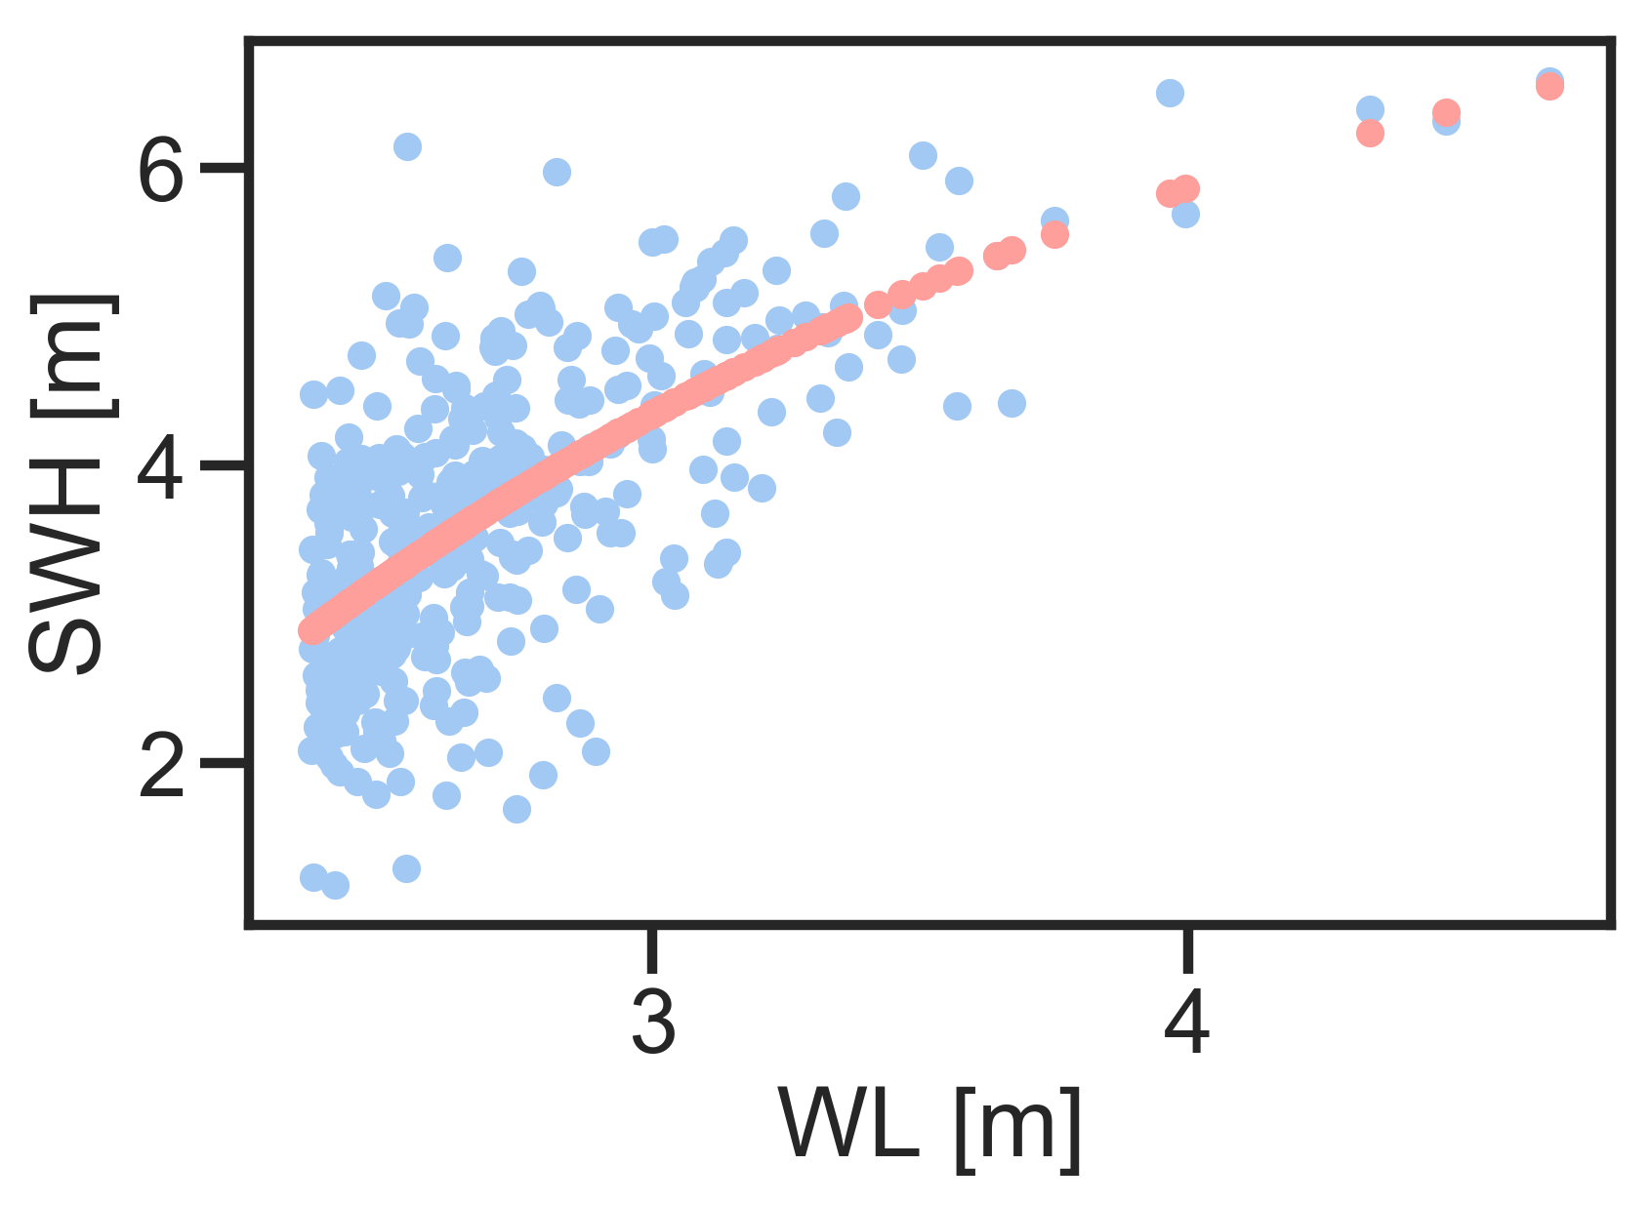
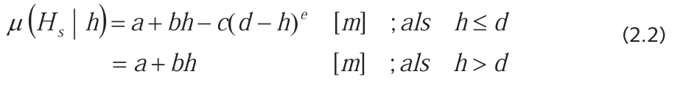
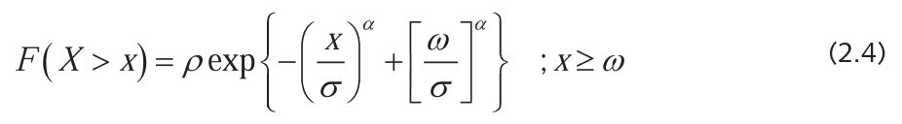
MODELLING ACTIVITIES North Sea use case
Methode 2006. Dune Design Criterias. SCHI
Historical (1976-2005)
ERA5 (2001-2017)
RCP4.5 (2071-2100)
RCP8.5 (2041-2071)
run | hist | ERA5 | RCP45 | RCP85
pos | SCHI | SCHI | SCHI | SCHI
a | 4.94 | 11.53 | 3.26 | 3.91
b | 0.60 | 0.60 | 0.60 | 0.60
c | 0.04 | 2.37 | 0.00 | 0.01
d | 7.00 | 7.00 | 7.00 | 7.00
e | 2.70 | 0.91 | 7.02 | 3.95

Slide 62
MODELLING ACTIVITIES North Sea use case
                CONCLUSIONS?
  Mean Regime (every day loadings)
    Mean wave direction shift towards the north
    Reduction in wave power available
    Reduction in Storm Surges
    Changes in Tide amplitudes (phase not explored but sure there are changes)
    Increase in water levels is reduced by changes in tide and surges in an accelerated sea level rise scenario
  Extreme Regime (exceptional loadings)
    Extreme waves are similar, reducing the number of events and the persistence
    Extreme surges are smaller, with a reduction in the number of events and persistence

Slide 63
MODELLING ACTIVITIES North Sea use case
1970
2000
2040
2070
2100

